Slide 1
AR-coated rCBGs 900-920nm
MIT TESTING
Arianna Bresci
02/04/2026

Slide 2
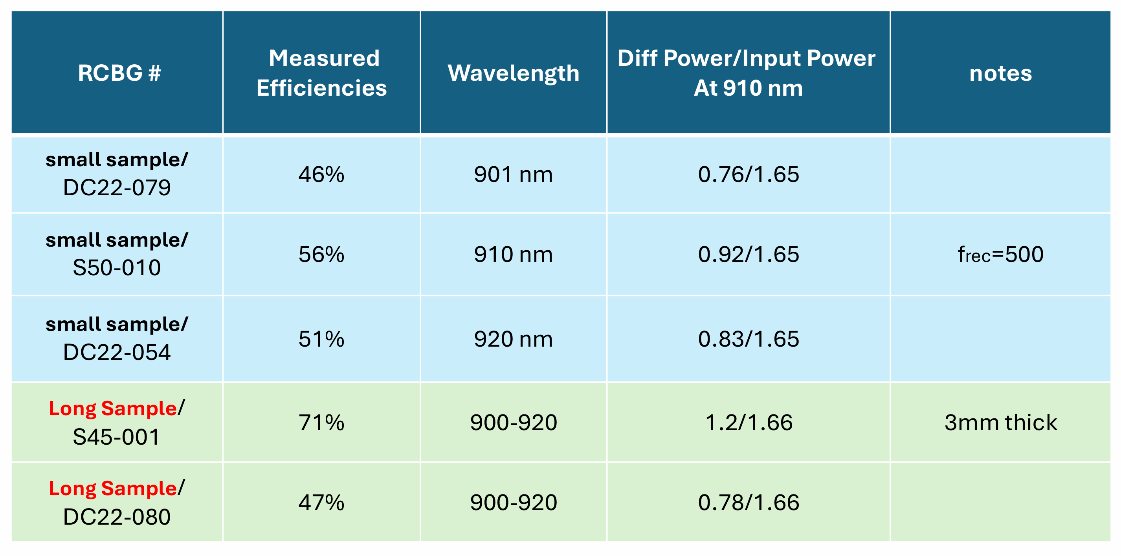
CREOL spec sheet

Slide 3
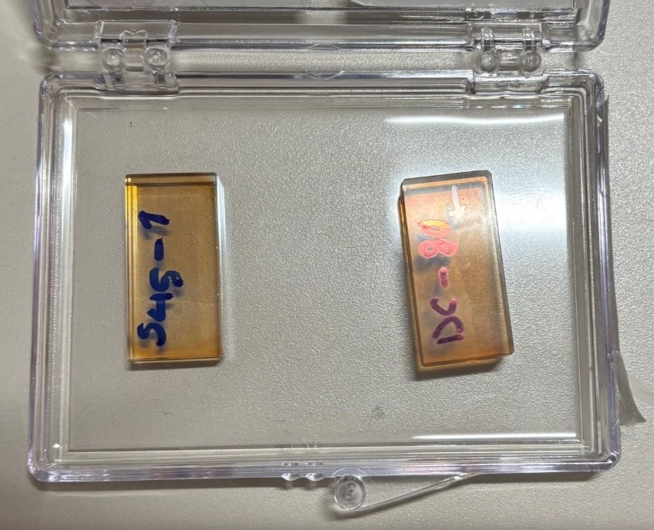
S45-001

Slide 4
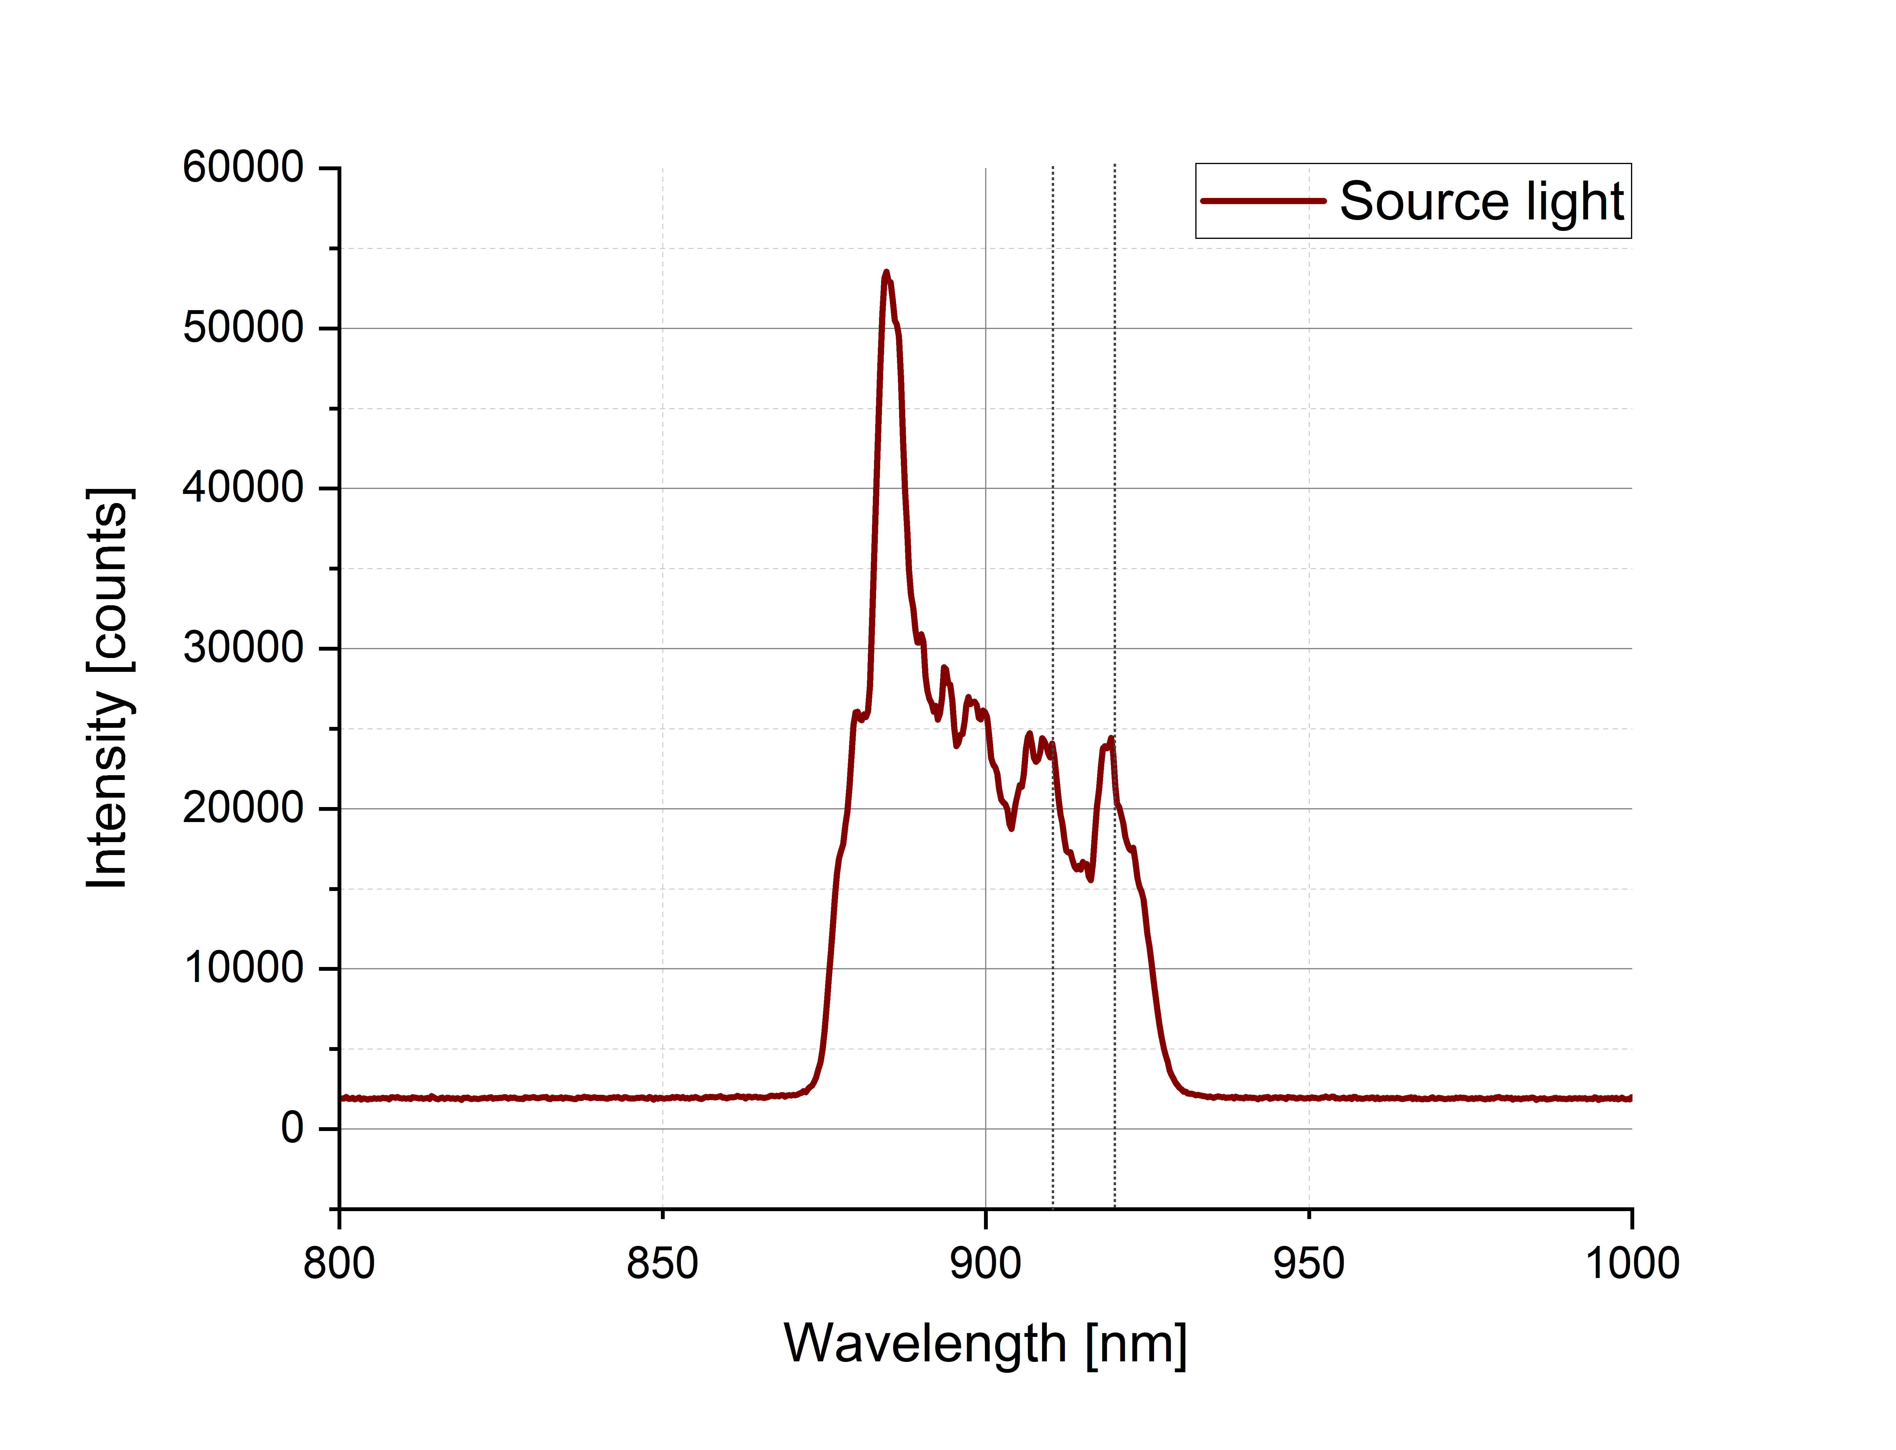
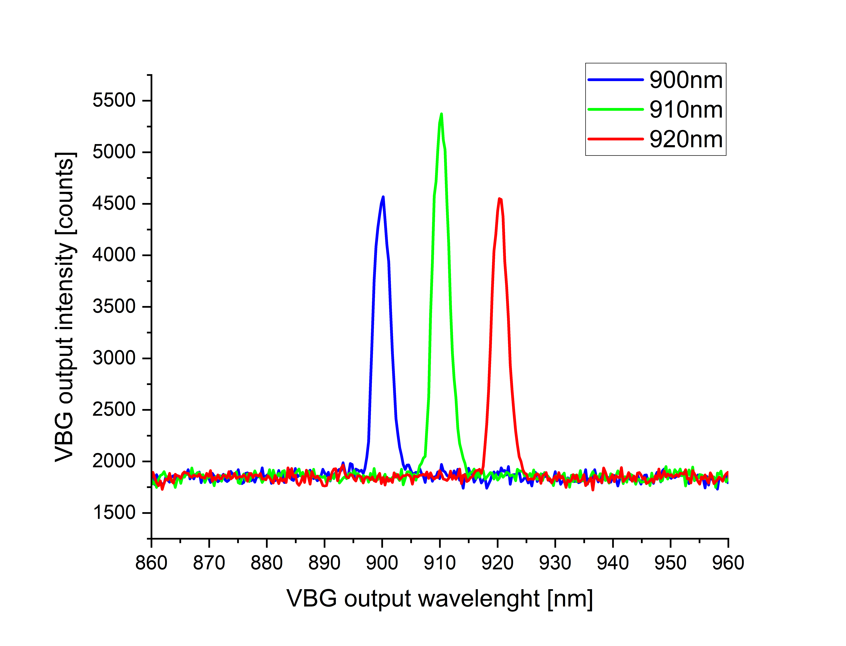
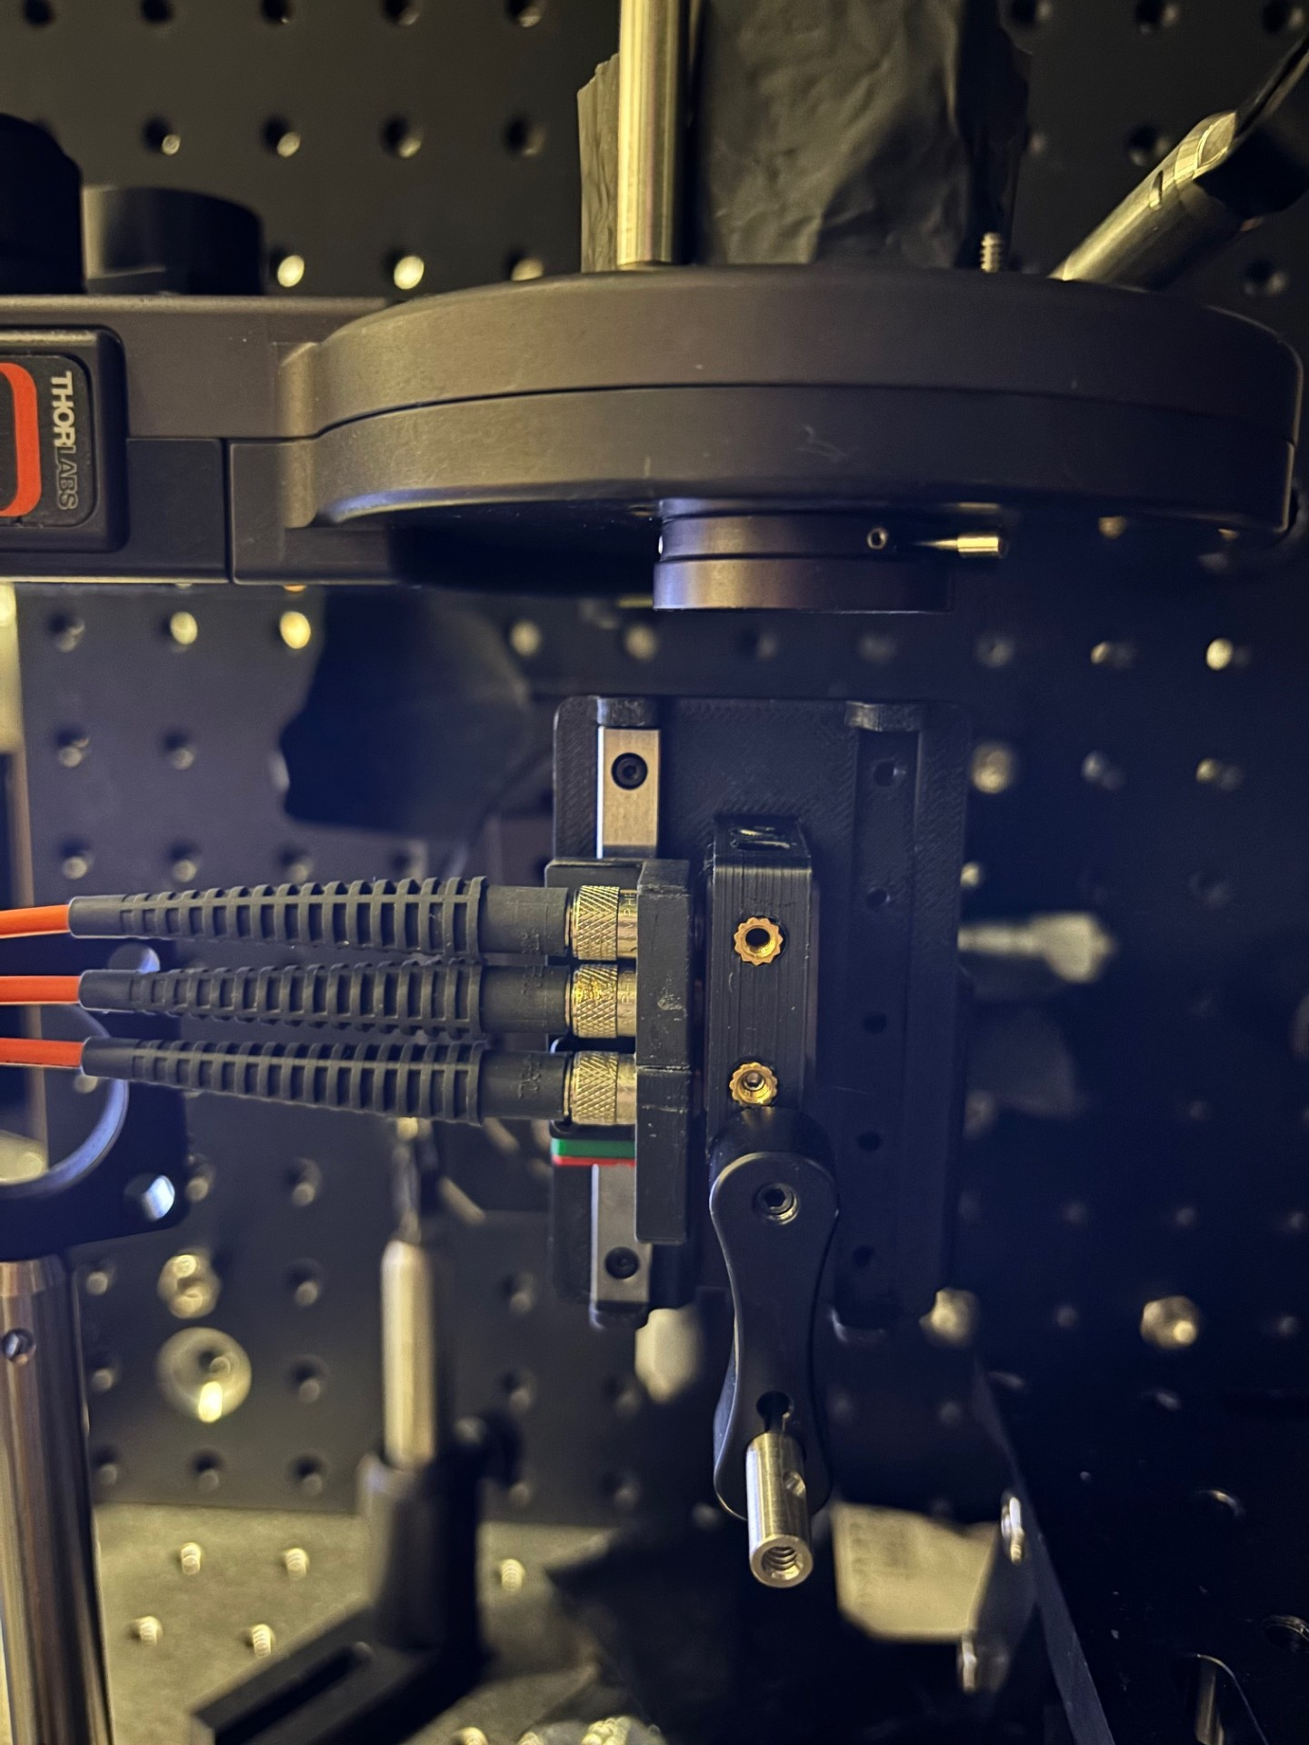
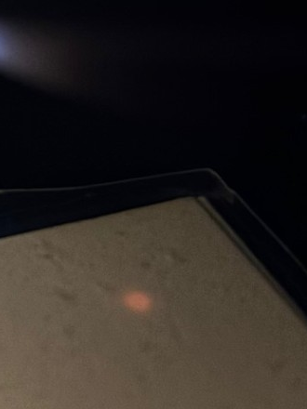
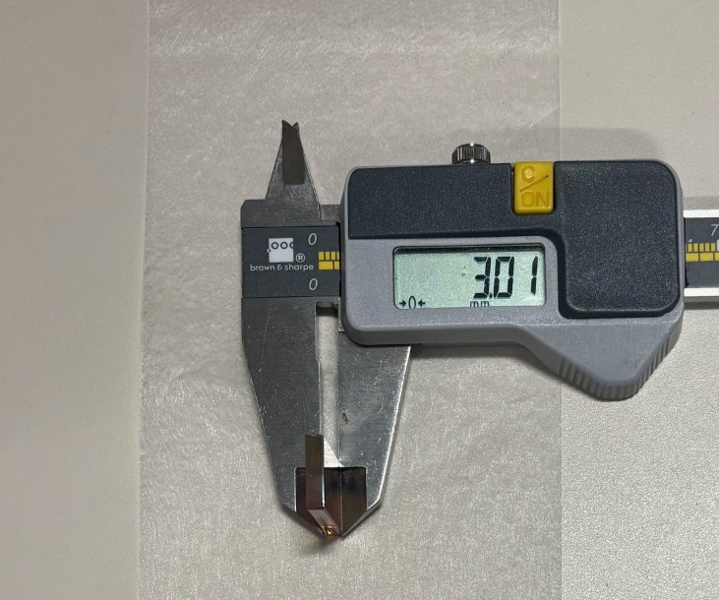
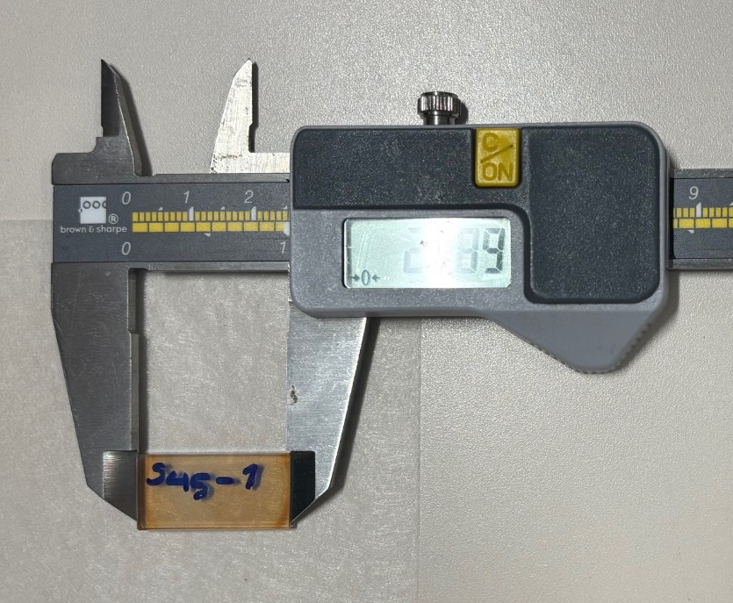
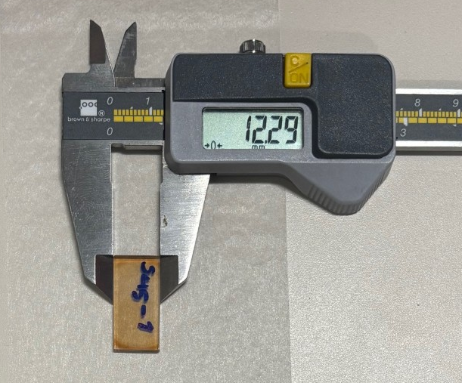
S45-001
Spectral flatness looks ok, slightly transmission at 910 nm
might be due to alignment
3.01 mm
24.89 mm
12.29 mm
rCBGs testbed
1mm input beam waist

Slide 5
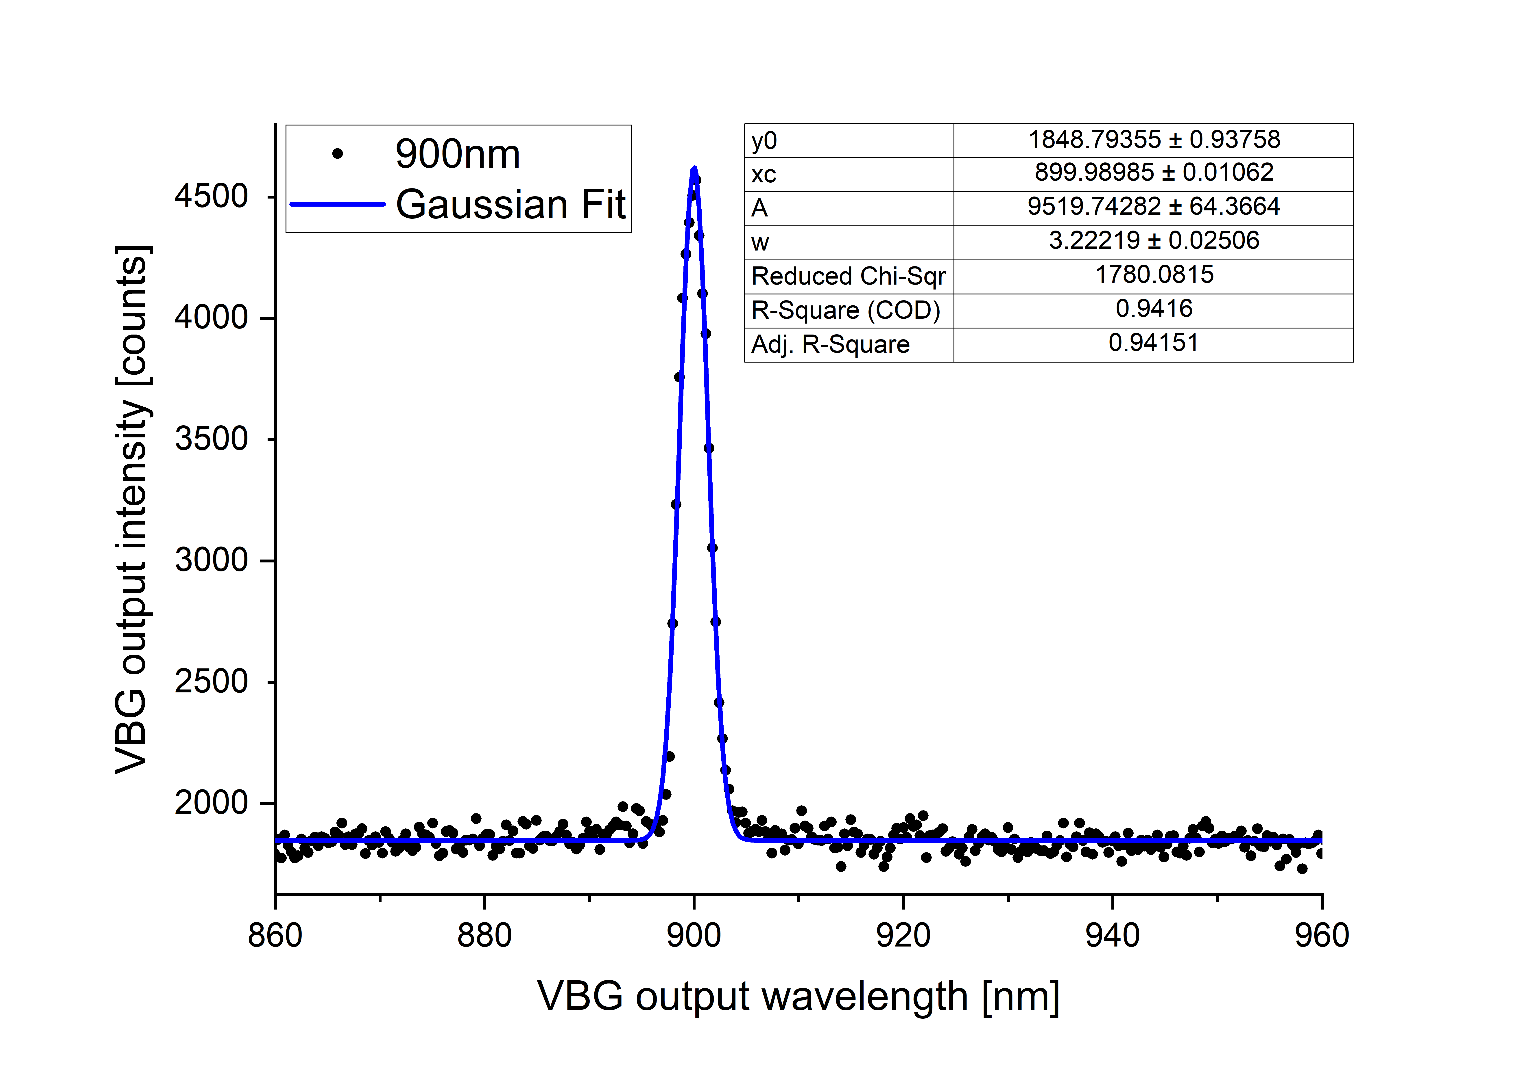
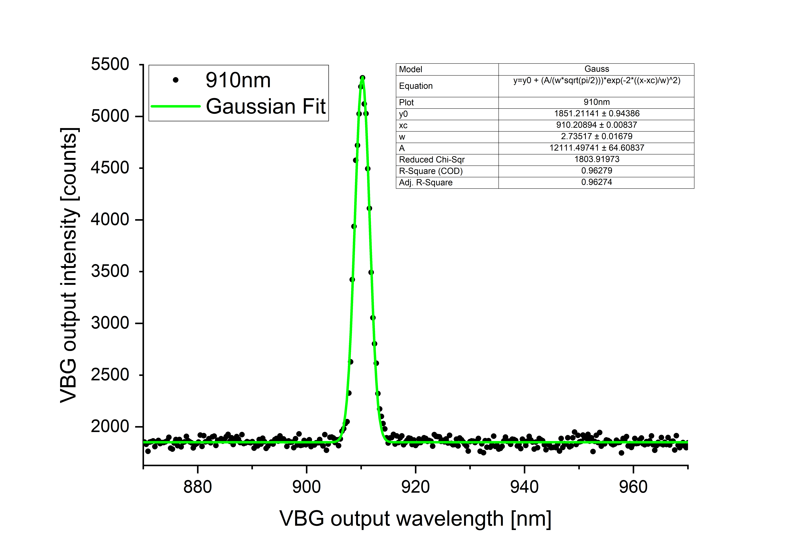
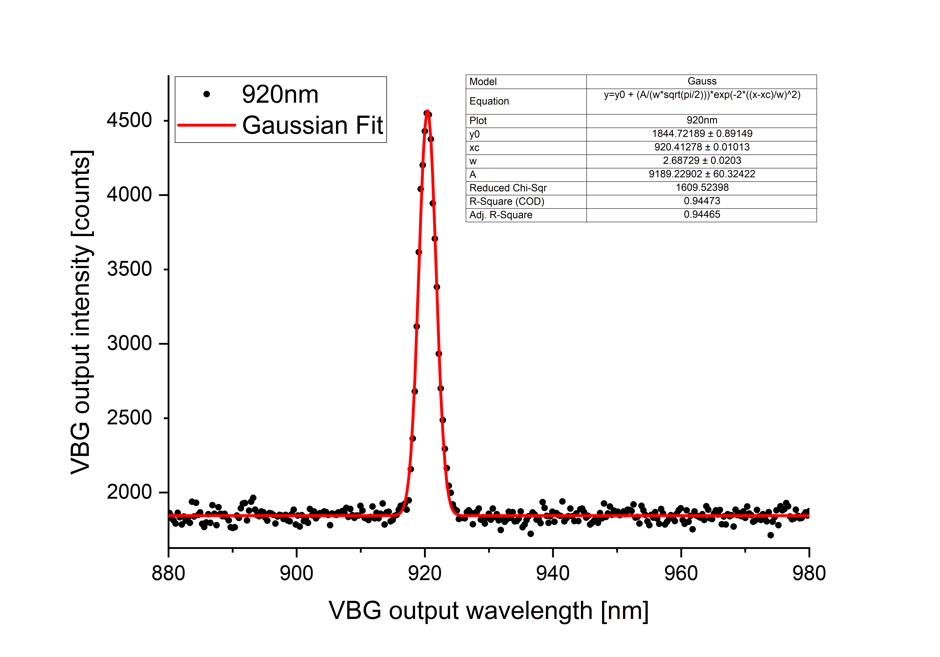
S45-001
1mm input beam waist
FWHM 3.2 nm
FWHM 2.7 nm
FWHM 2.7 nm

Slide 6
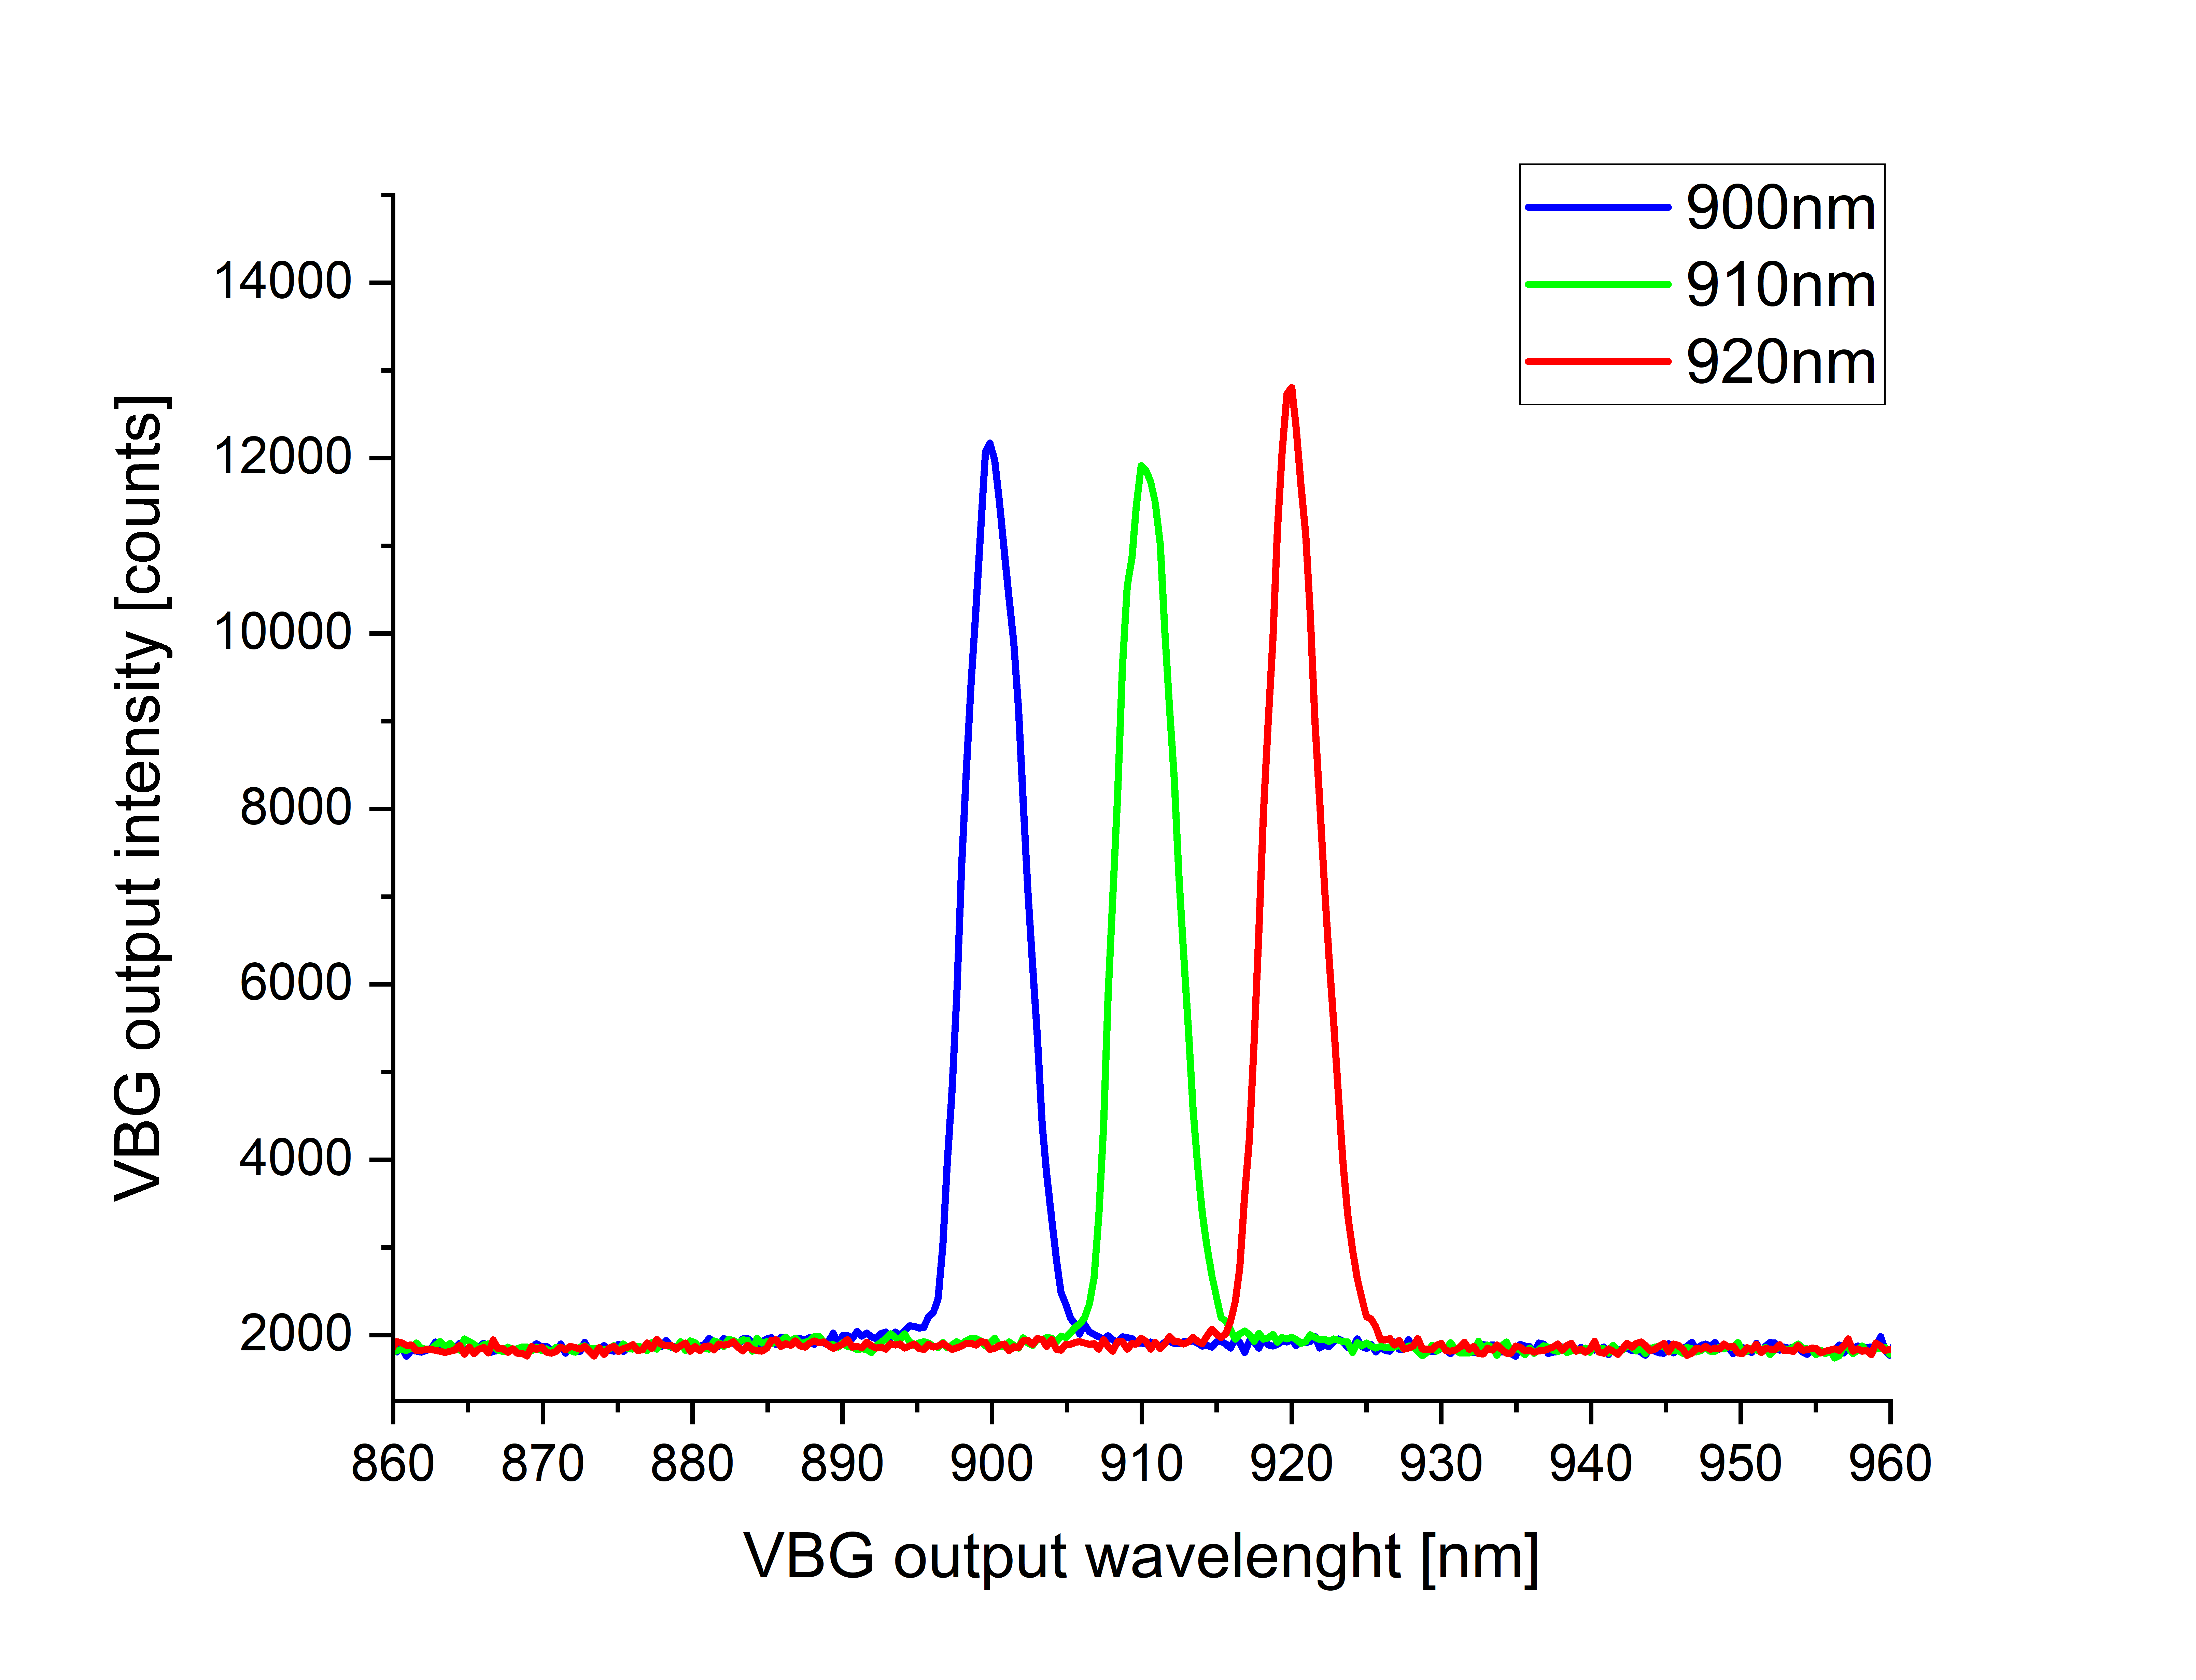
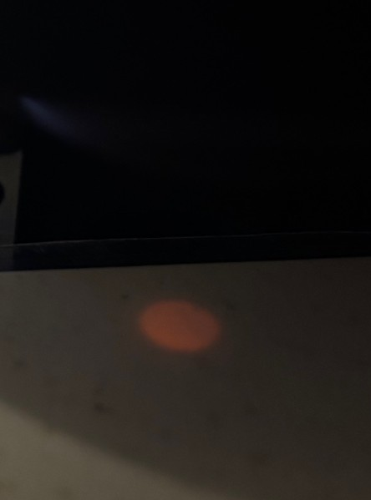
S45-001
Spectral flatness looks ok
3.01 mm
24.89 mm
12.29 mm
rCBGs testbed
5mm input beam waist

Slide 7
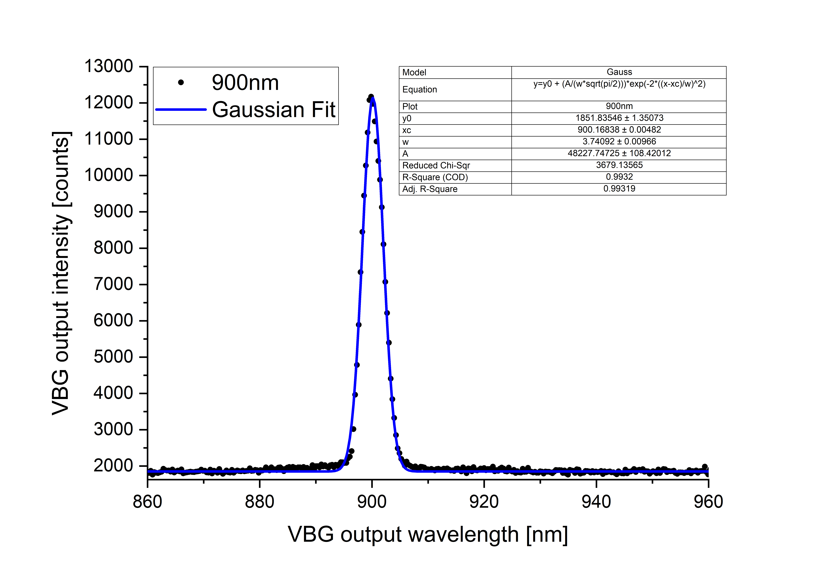
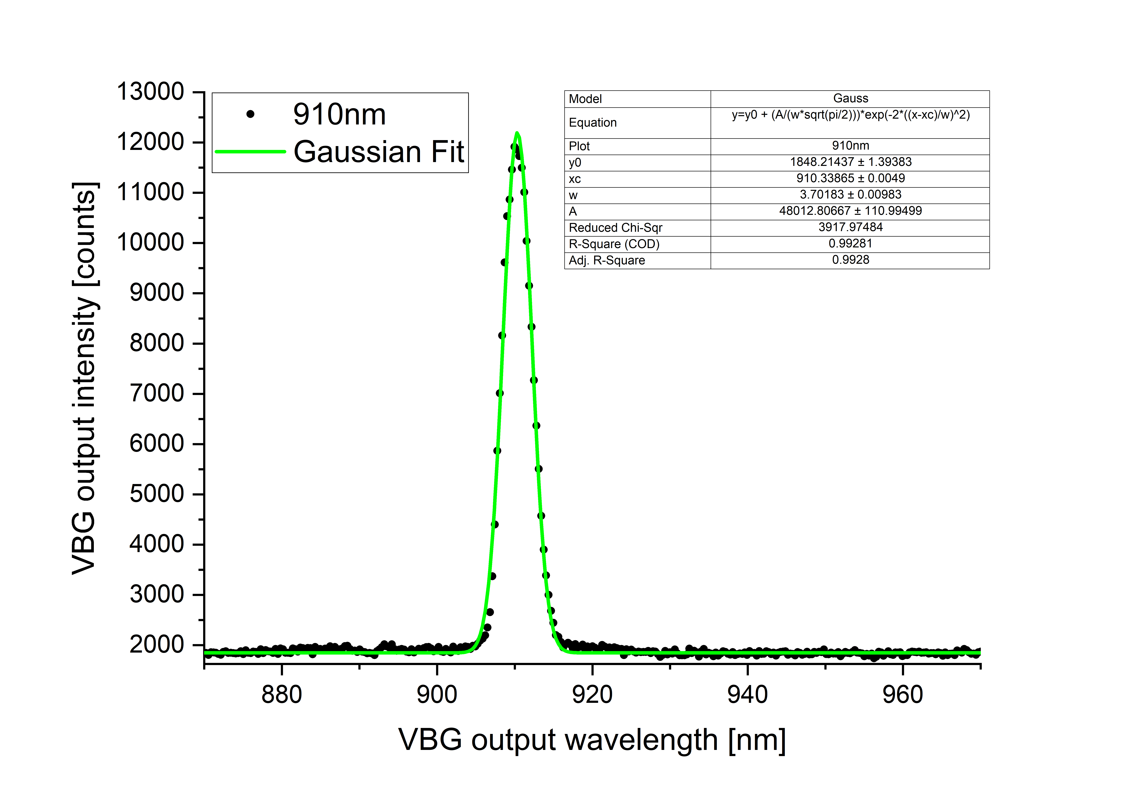
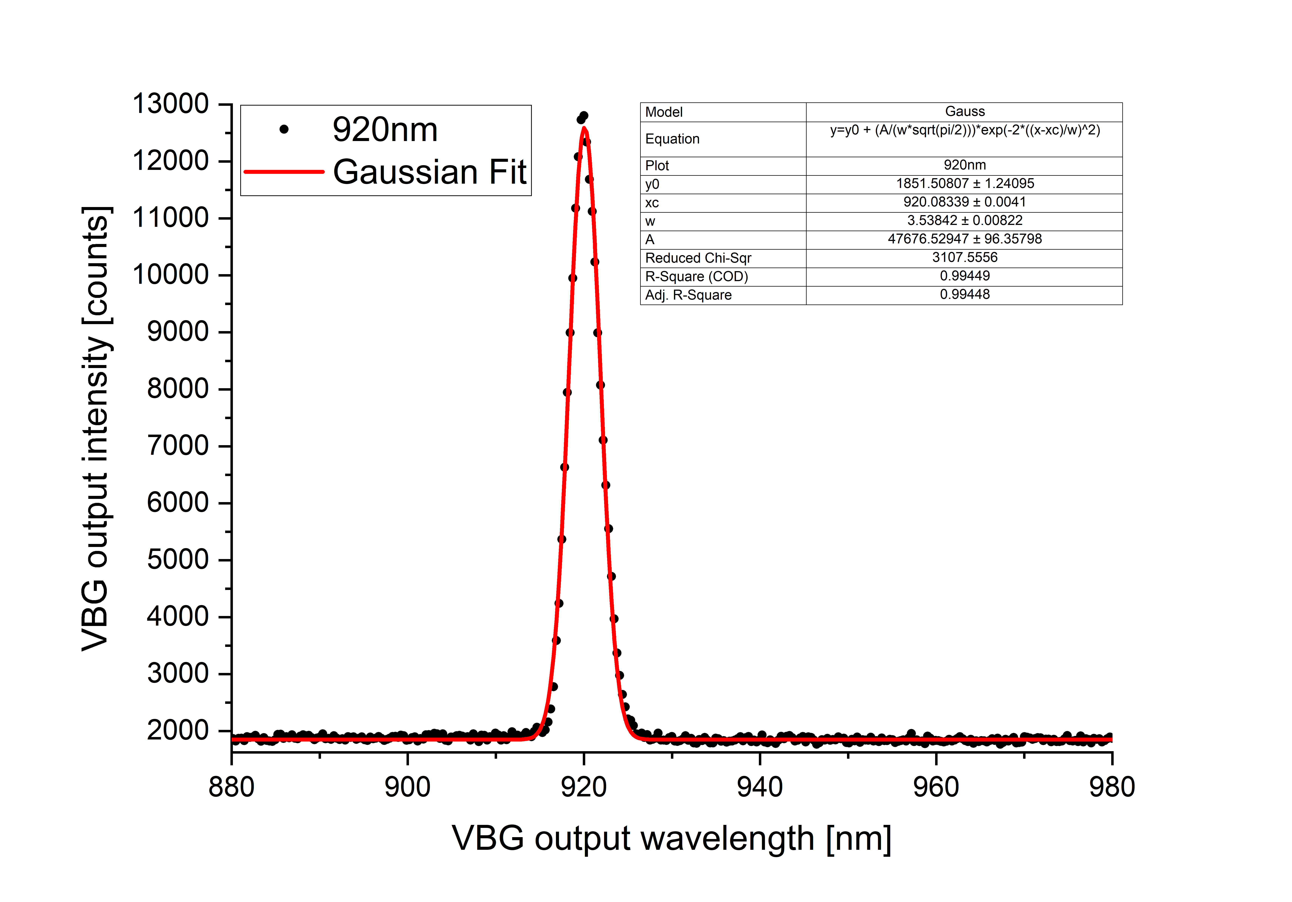
S45-001
5mm input beam waist
FWHM 3.7 nm
(instead of 3.2 with
1mm input beam waist)
FWHM 3.7 nm
(instead of 2.7 with
1mm input beam waist)
FWHM 3.5 nm
(instead of 2.7 with
1mm input beam waist)

Slide 8
DC22E-080

Slide 9
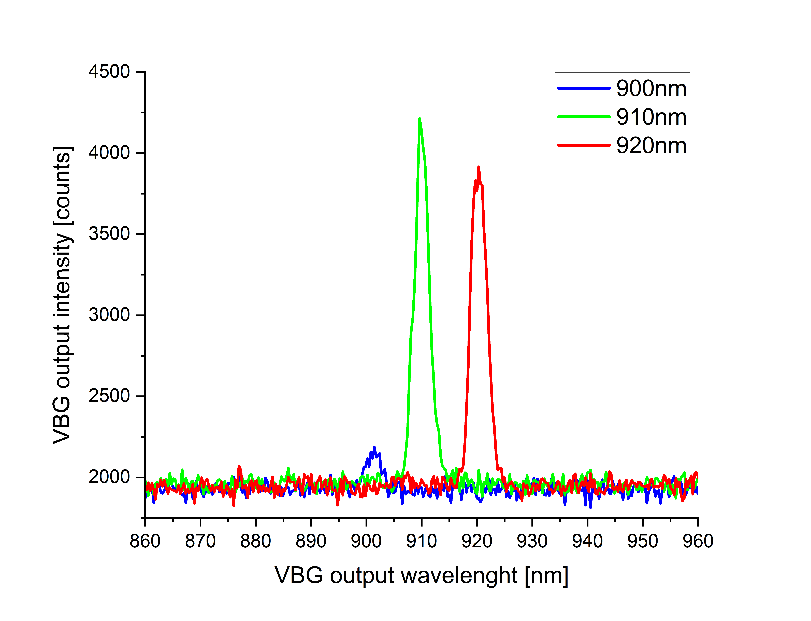
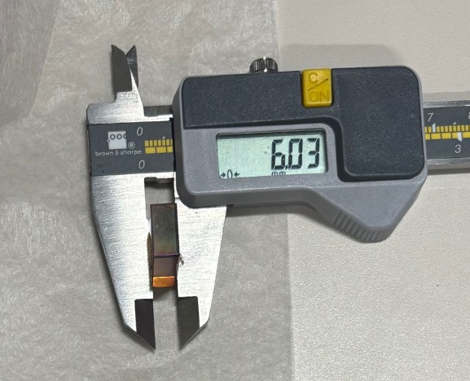
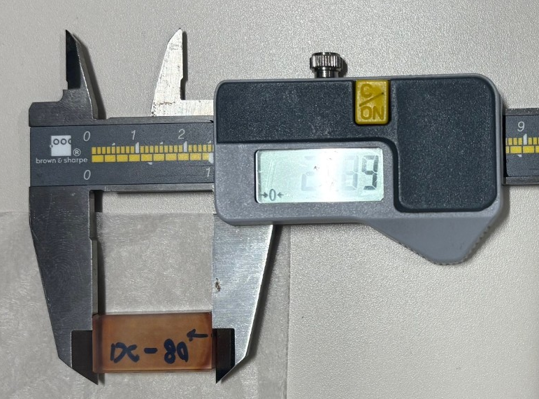
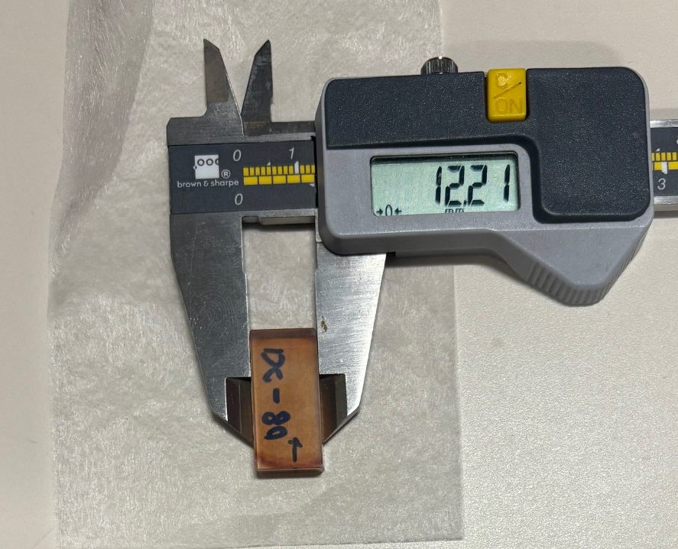
DC22E-080
Spectral flatness is lost below 905nm
6.03 mm
24.89 mm
12.21 mm
rCBGs testbed
1mm input beam waist

Slide 10
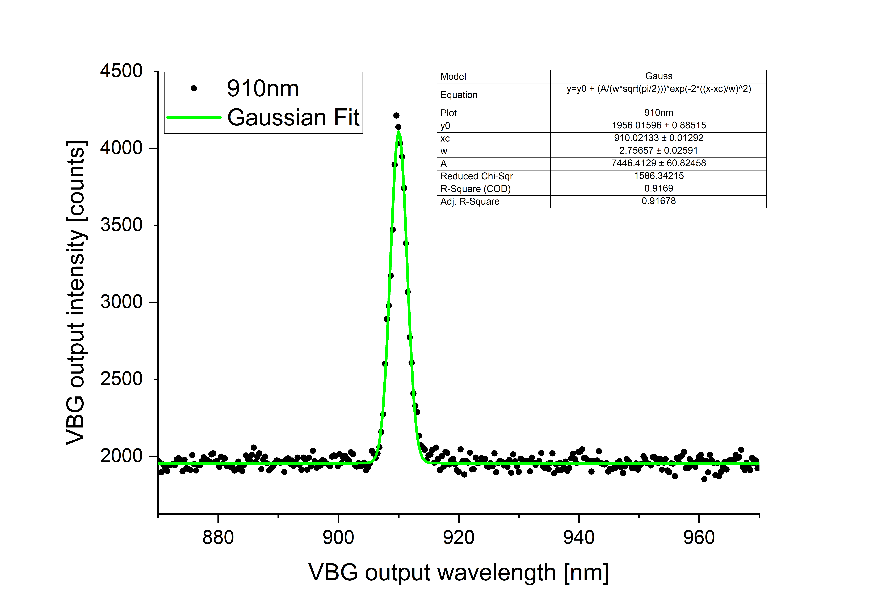
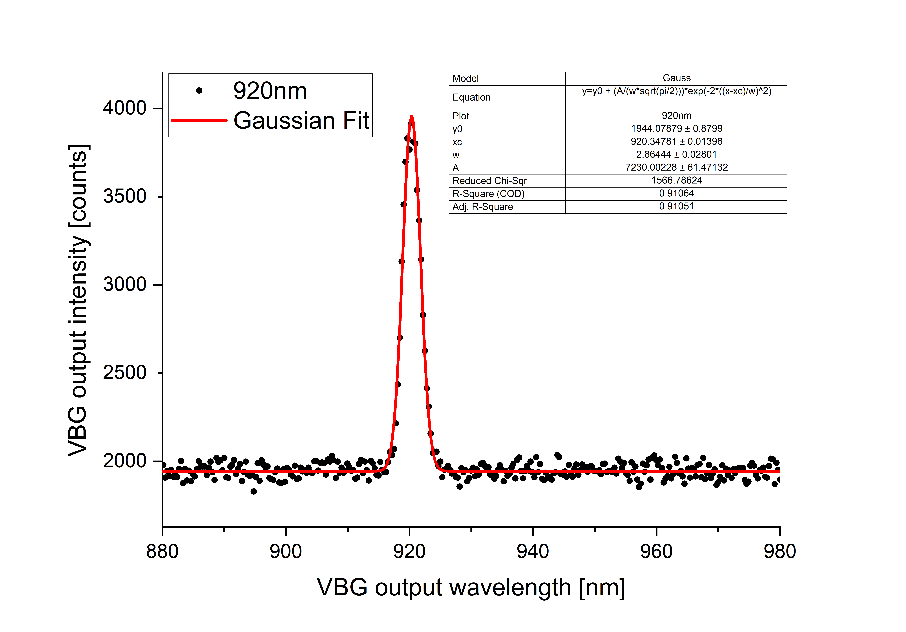
DC22E-080
1mm input beam waist
FWHM 2.7 nm
FWHM 2.9 nm
Fit fails, too noisy output at 900 nm

Slide 11
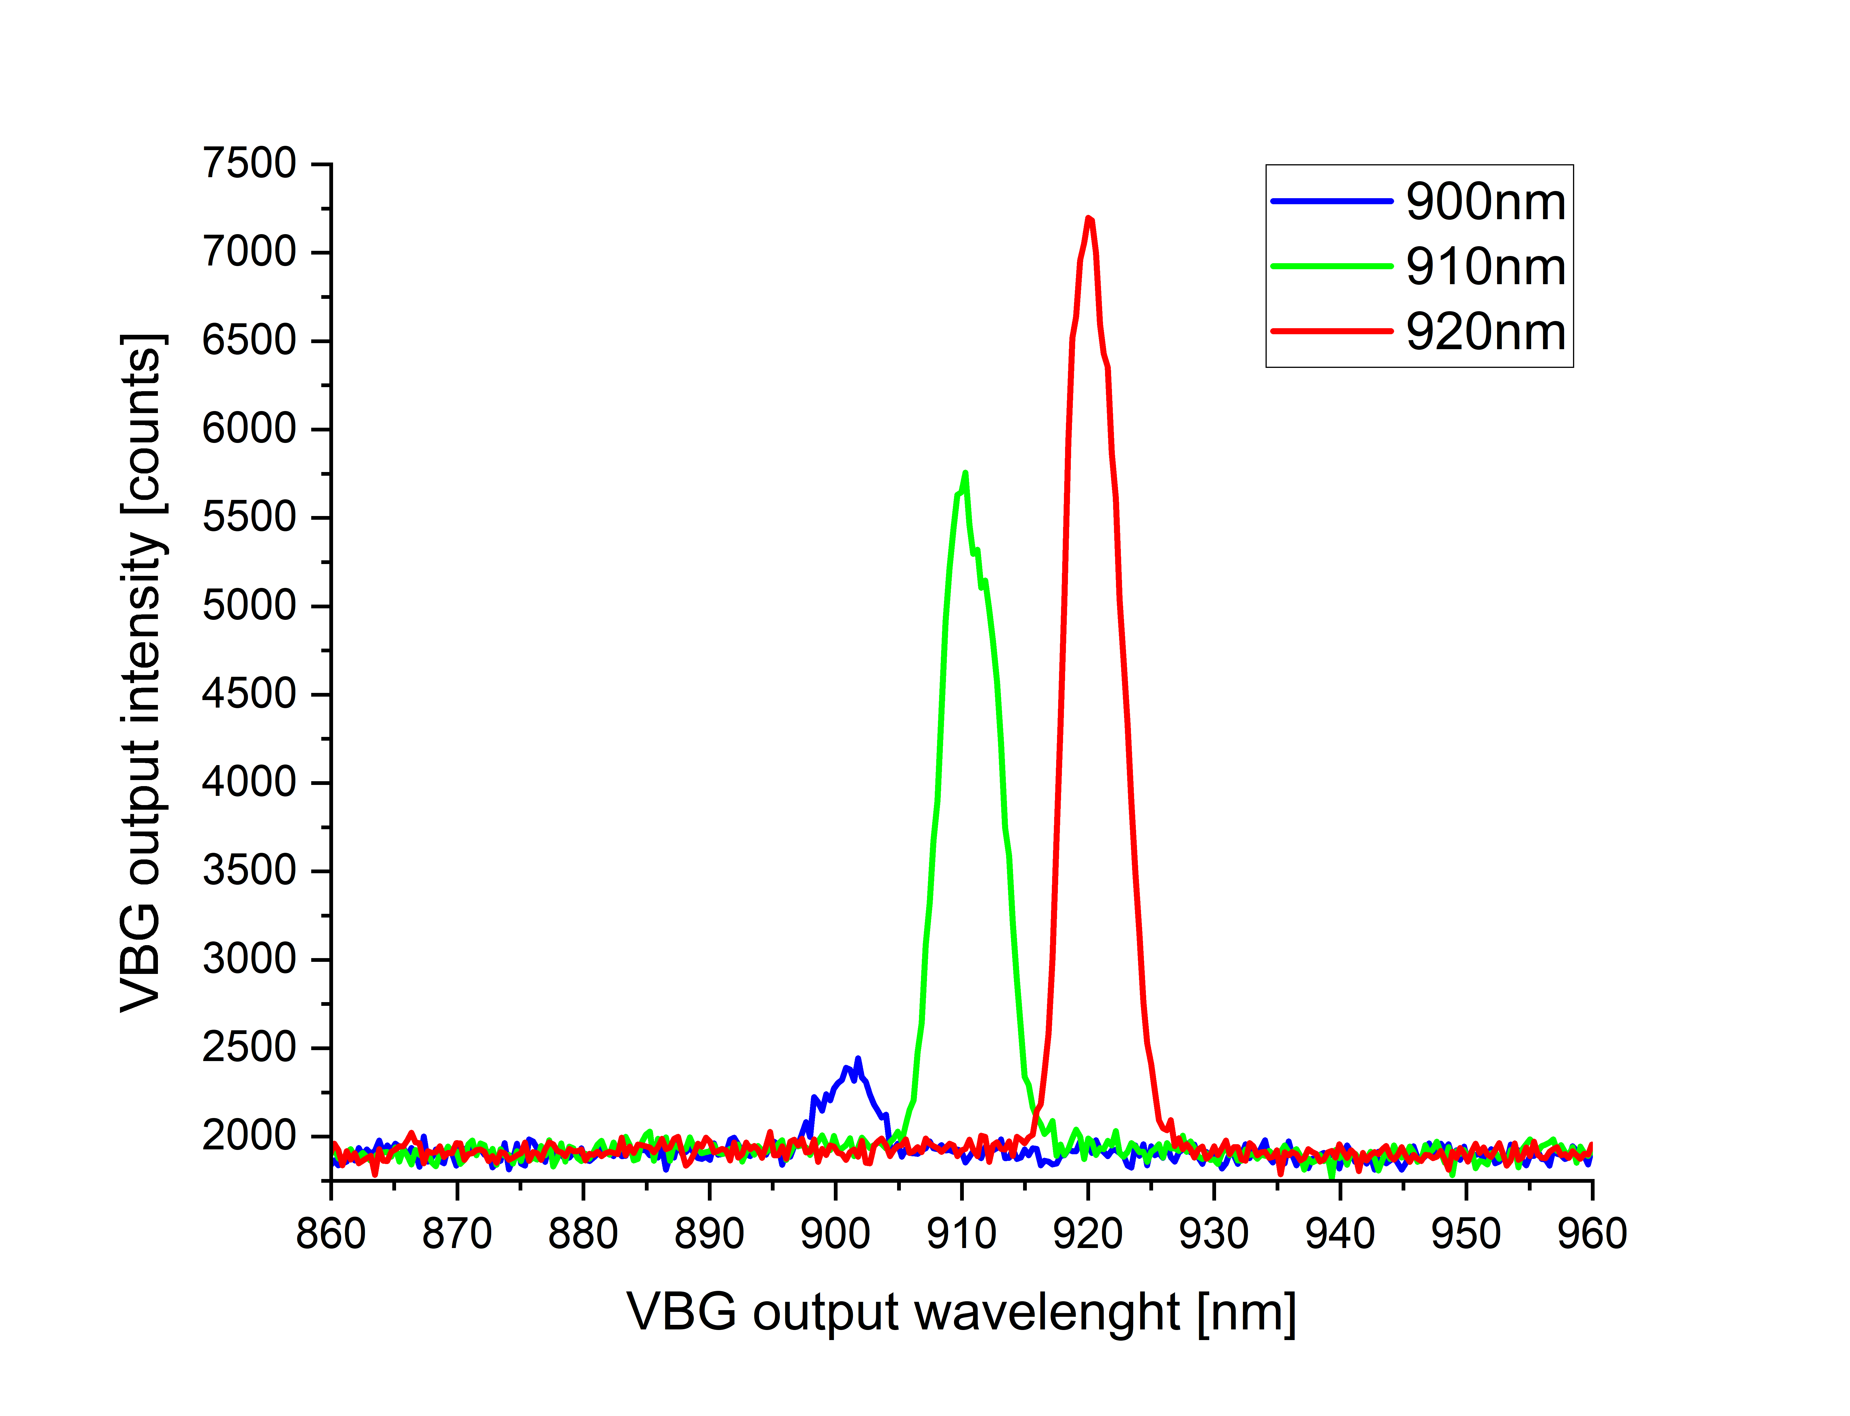
DC22E-080
Spectral flatness is lost below 905nm
6.03 mm
24.89 mm
12.21 mm
rCBGs testbed
5mm input beam waist

Slide 12
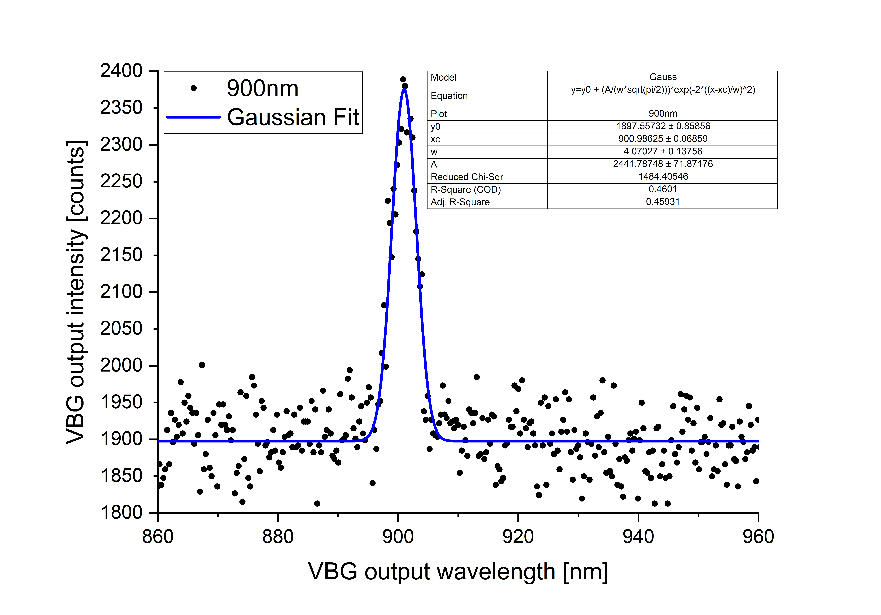
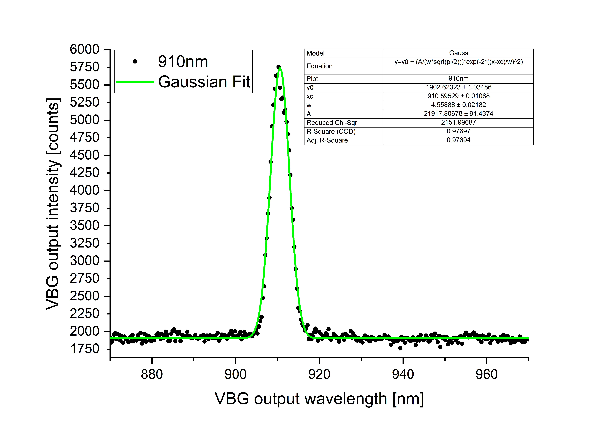
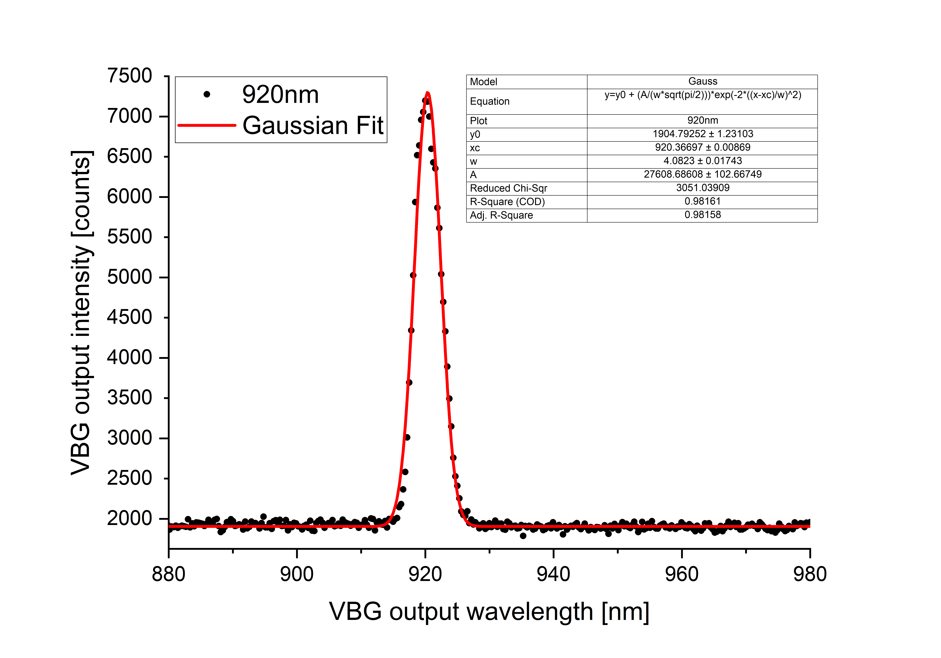
DC22E-080
5mm input beam waist
FWHM 4 nm
(instead of close to no output
with 1mm input beam waist)
FWHM 4.6 nm
(instead of 2.7 with
1mm input beam waist)
FWHM 4 nm
(instead of 2.9 with
1mm input beam waist)

Slide 13
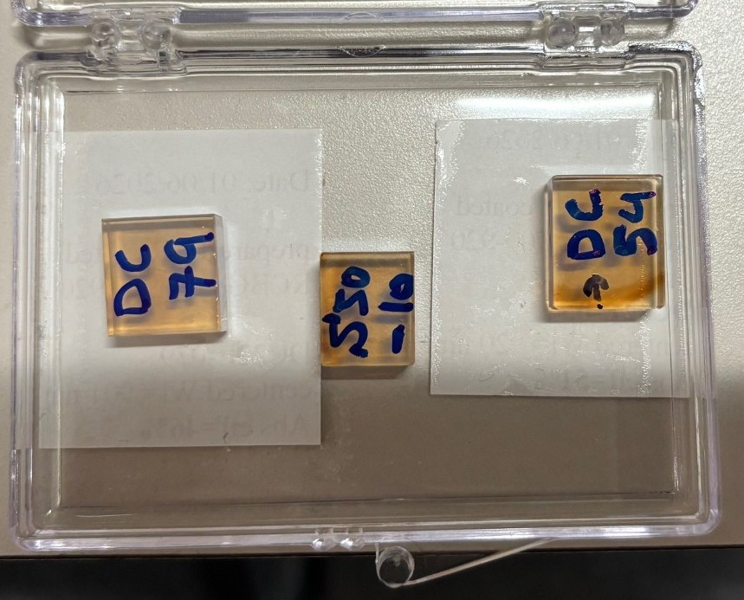
DC22-054

Slide 14
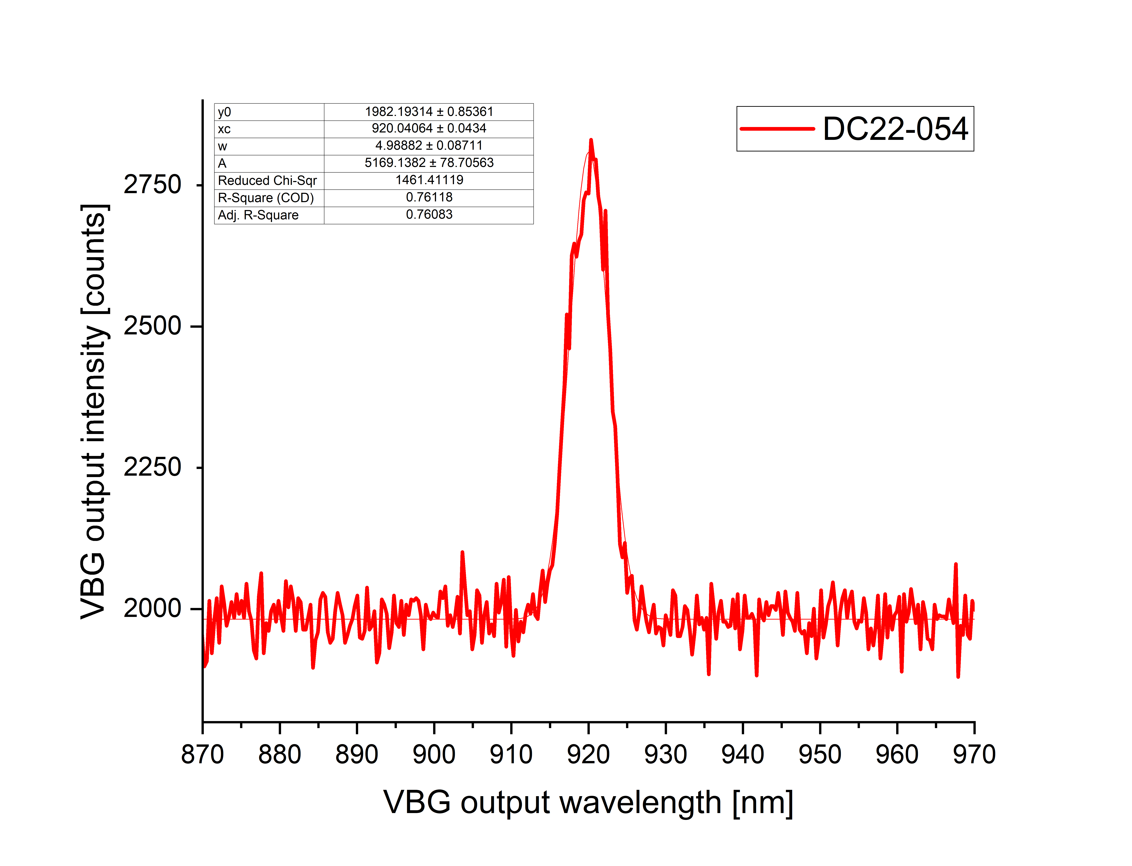
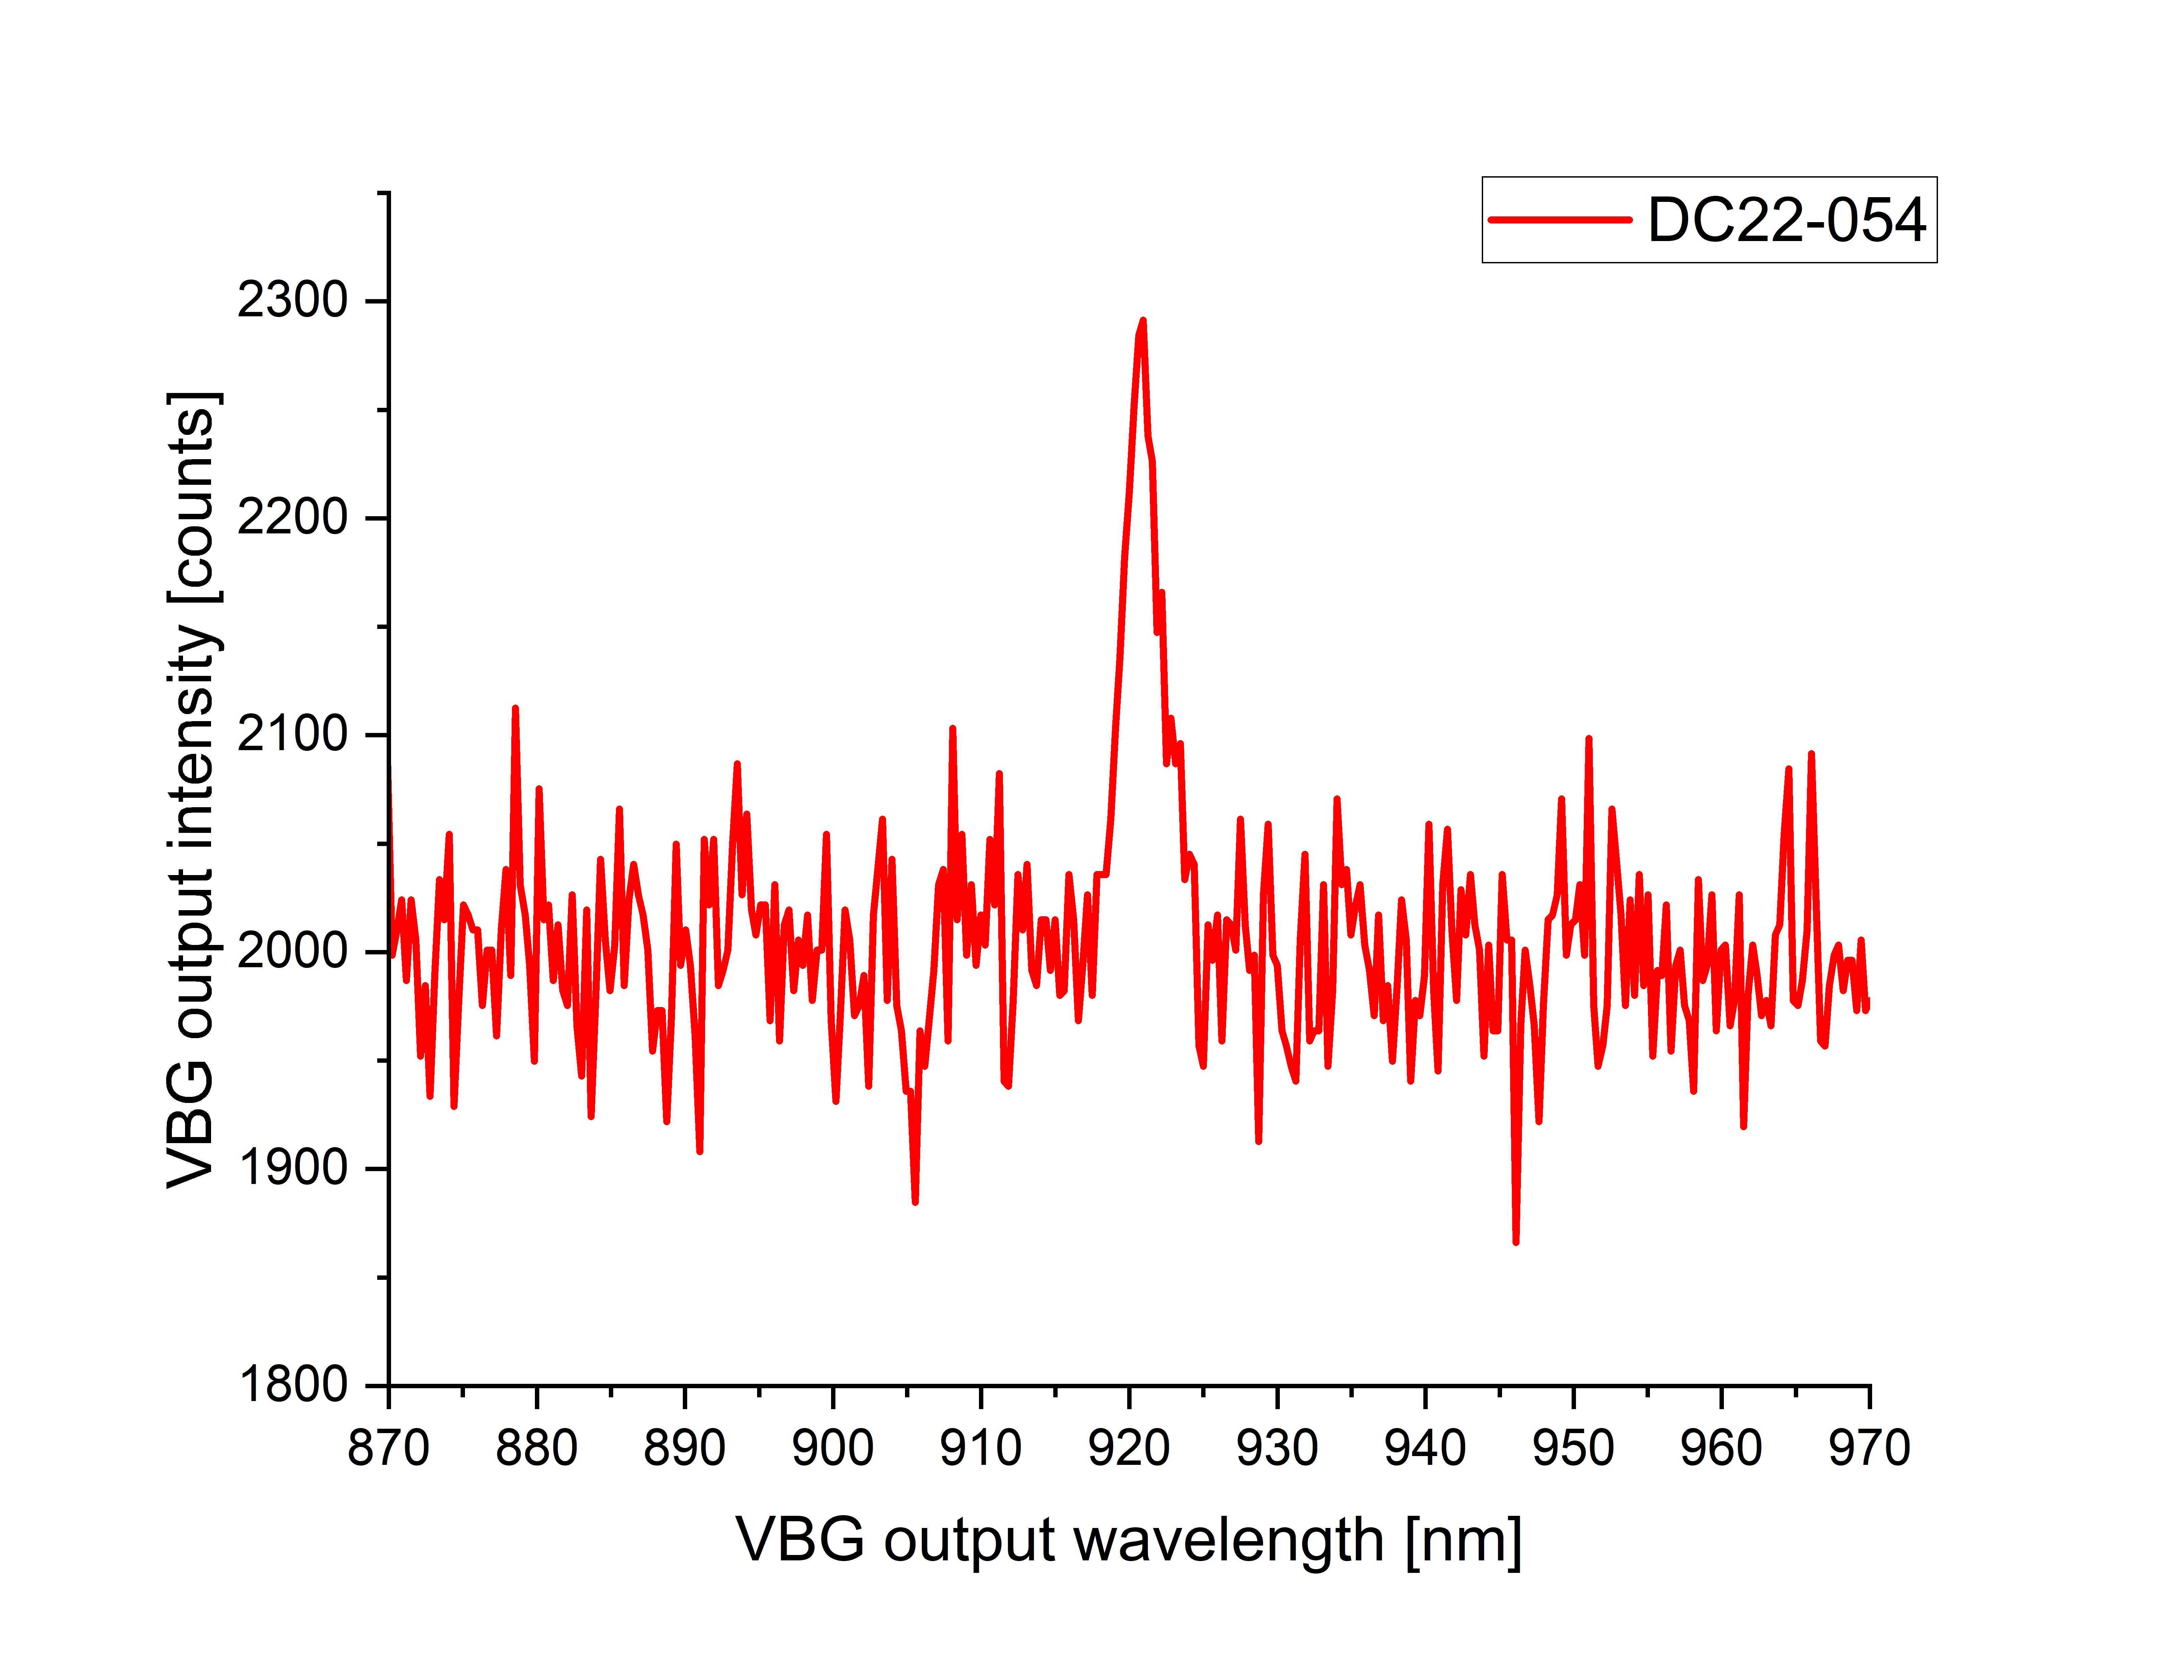
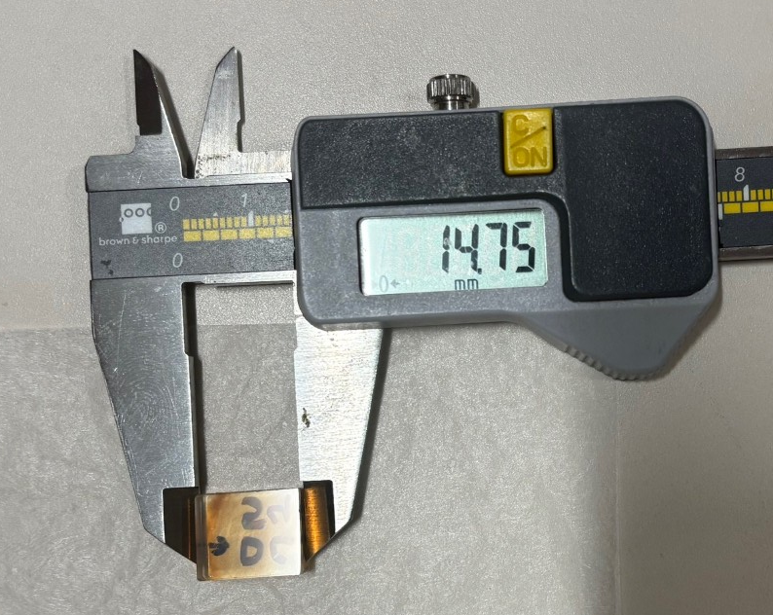
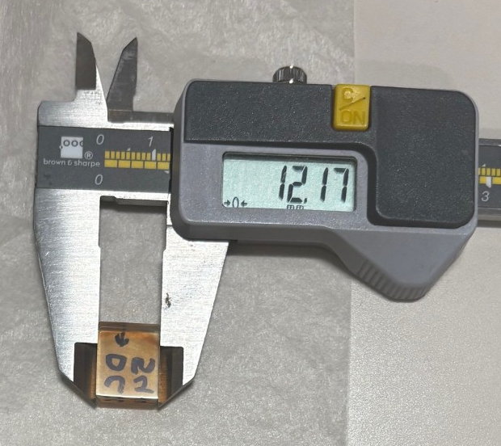
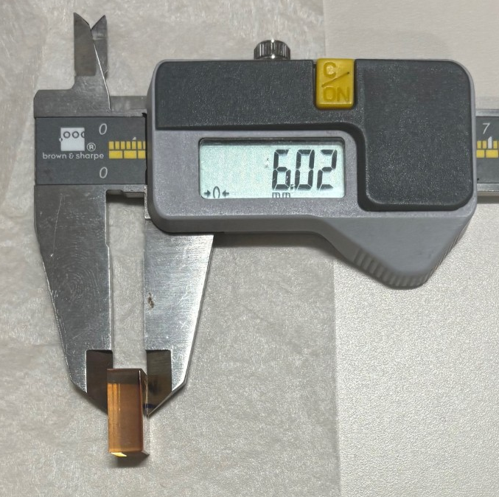
FWHM 5 nm
5mm input
beam waist
DC22-054
1mm input
beam waist
14.75 mm
24.89 mm
12.21 mm

Slide 15
S50-010

Slide 16
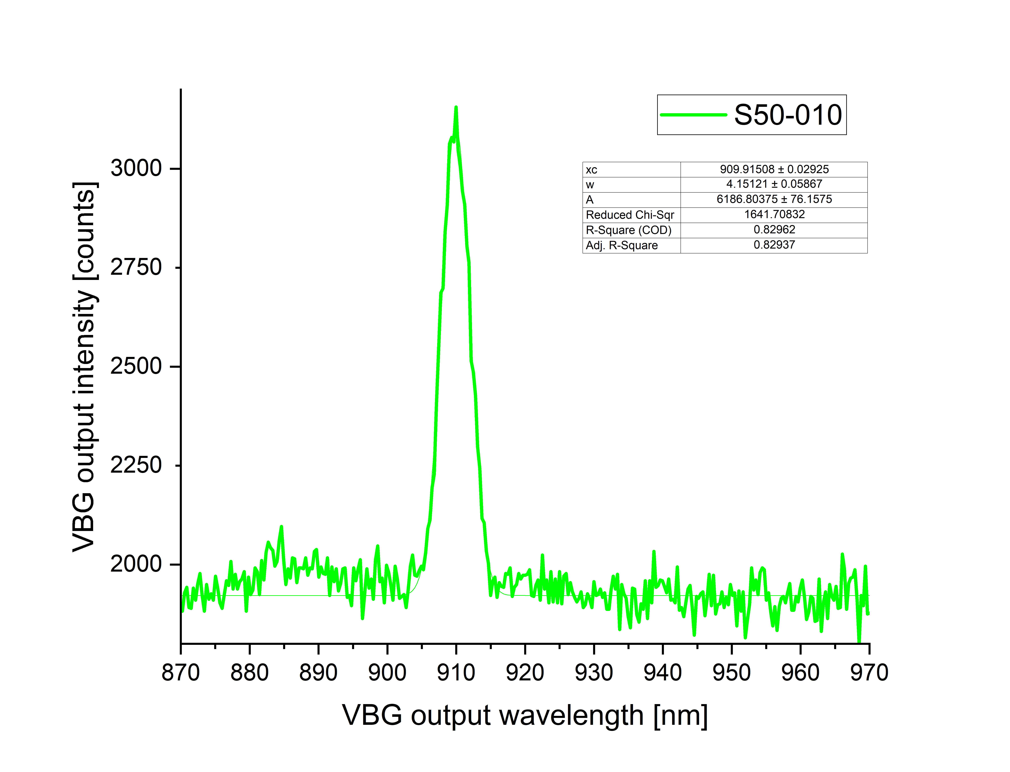
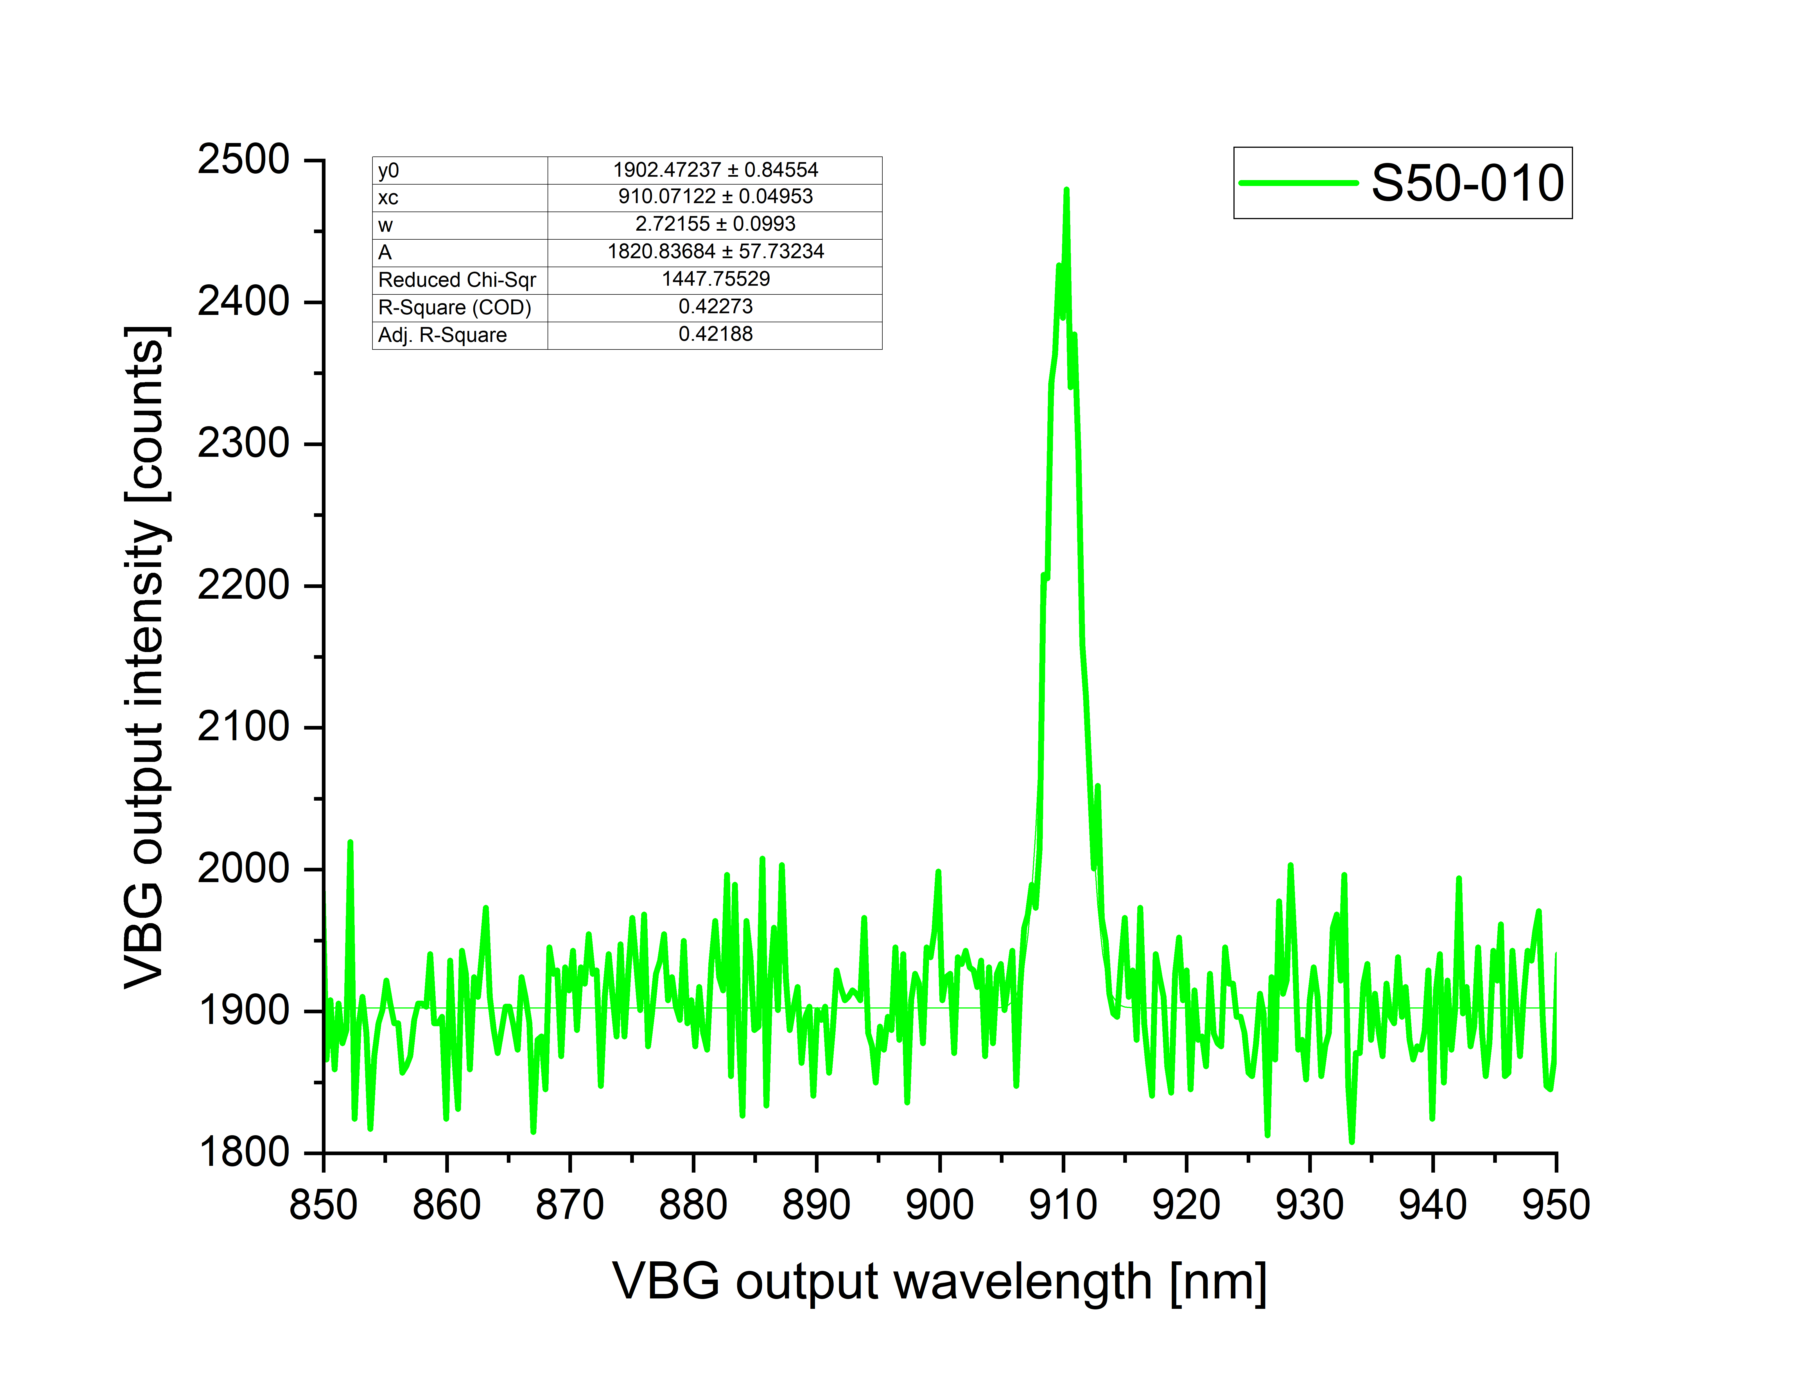
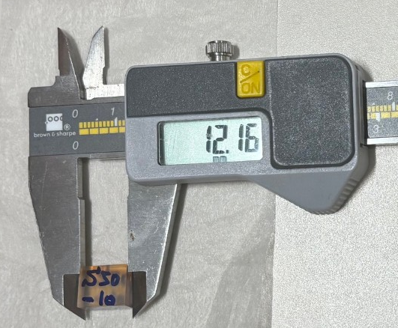
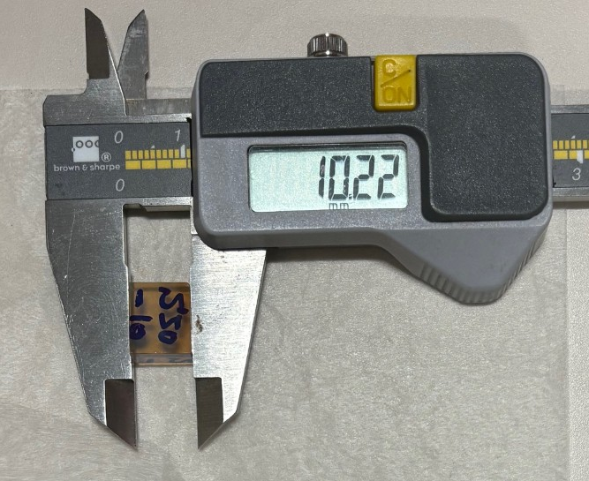
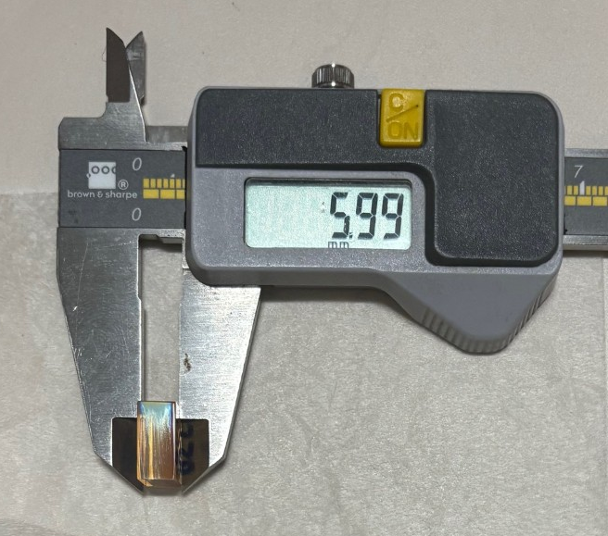
FWHM 4.1 nm
5mm input
beam waist
S50-010
FWHM 2.7 nm
12.16 mm
10.22 mm
5.99 mm
1mm input
beam waist

Slide 17
DC22-079

Slide 18
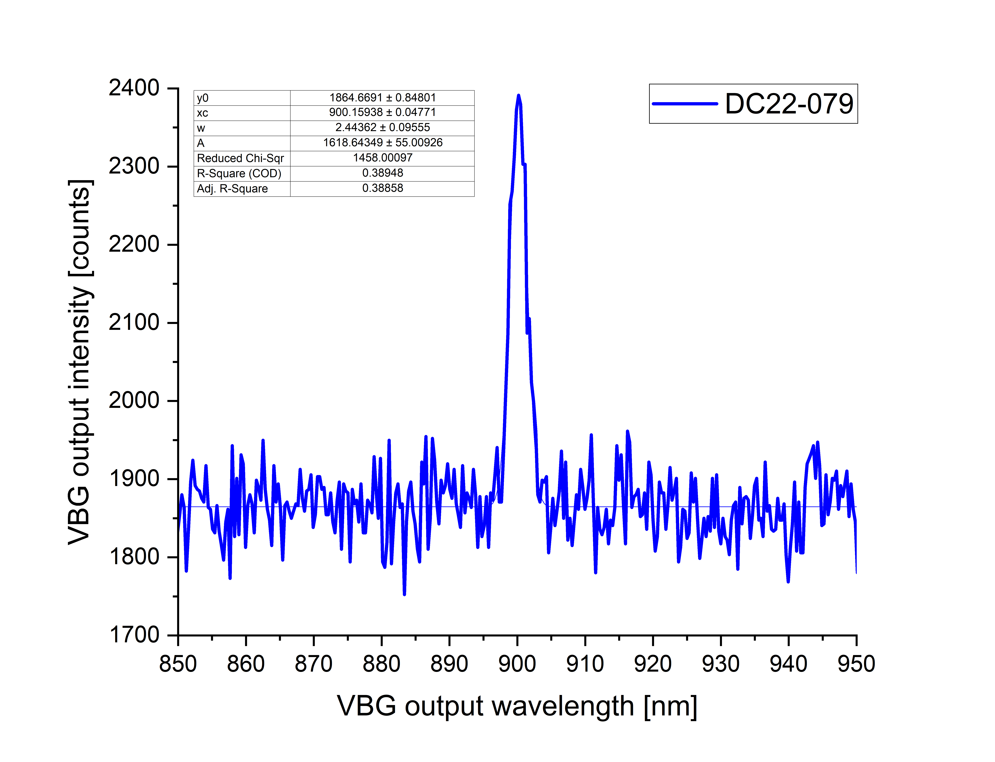
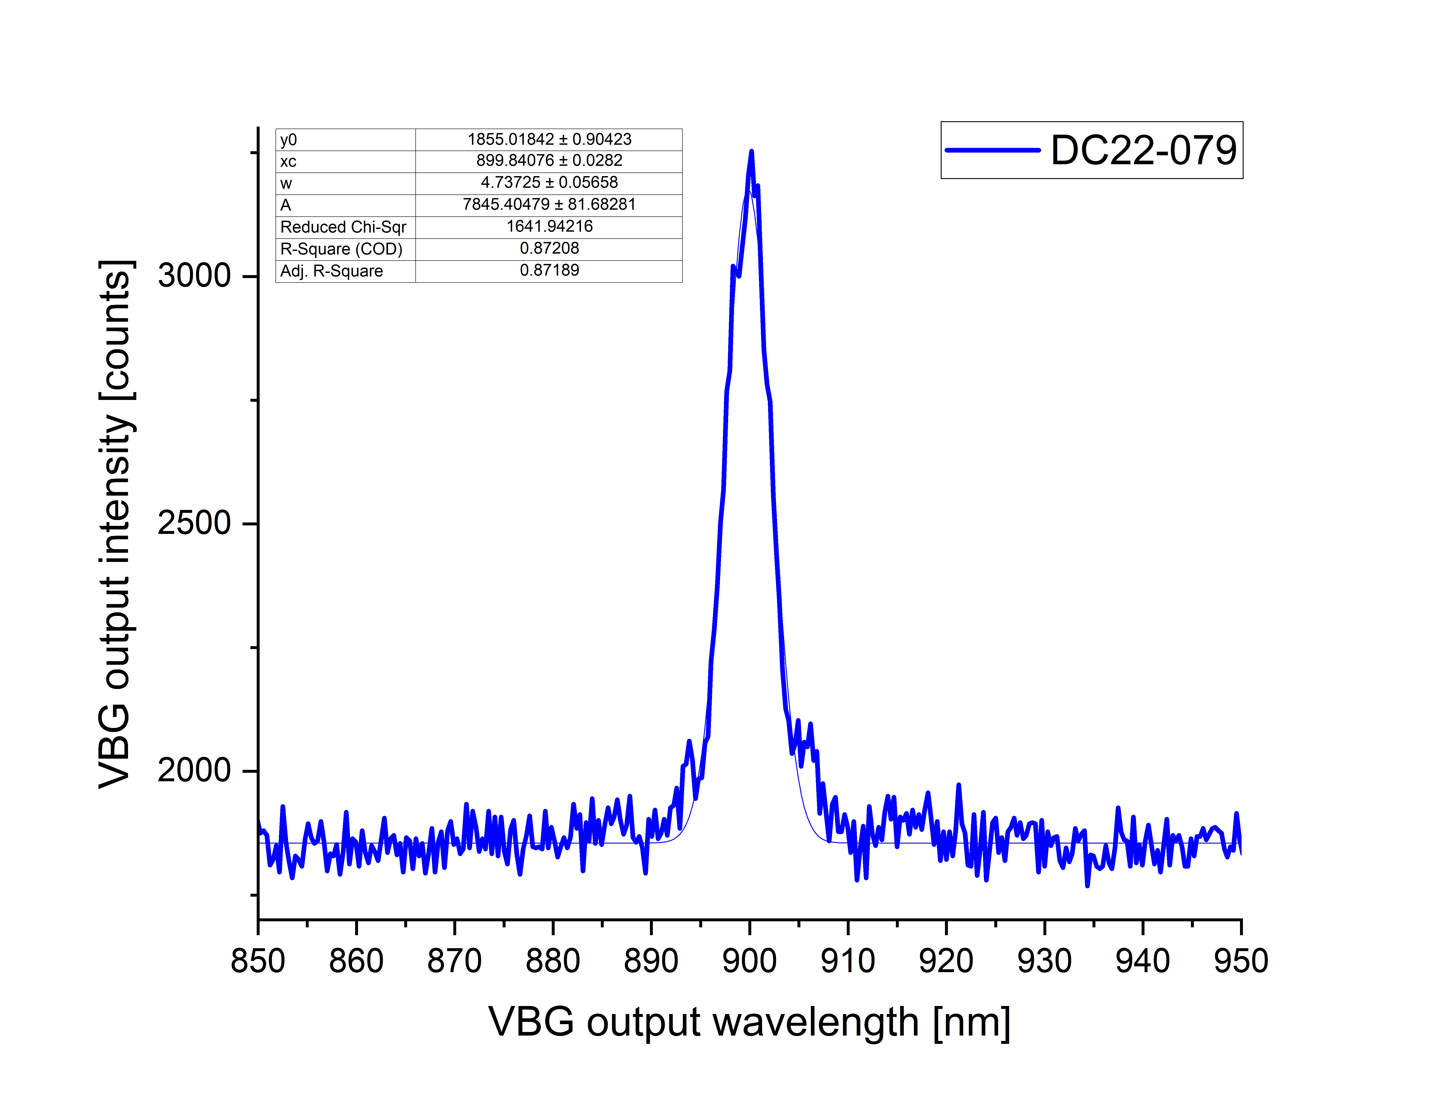
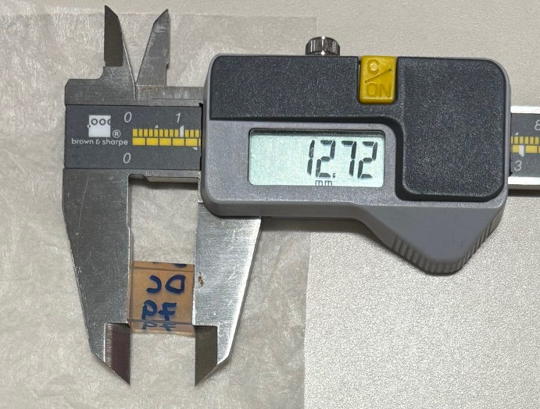
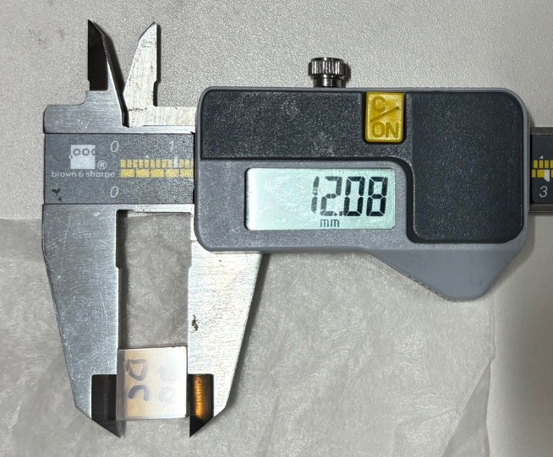
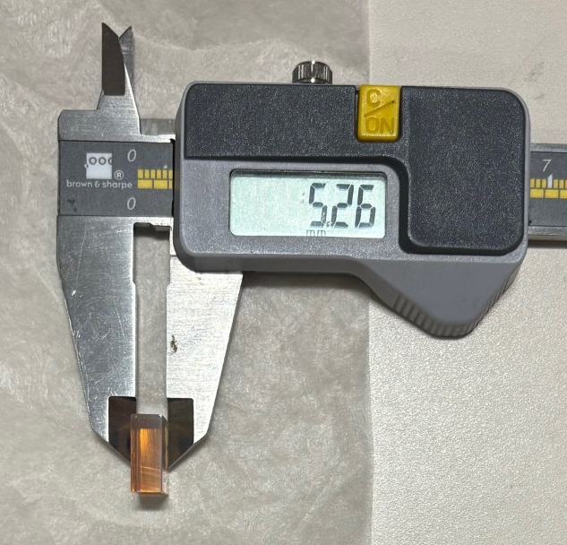
FWHM 2.4 nm
5mm input
beam waist
DC22-079
FWHM 4.7 nm
12.72 mm
10.08 mm
5.26 mm
1mm input
beam waist

Slide 19
S50-010
DC22-079

Slide 20
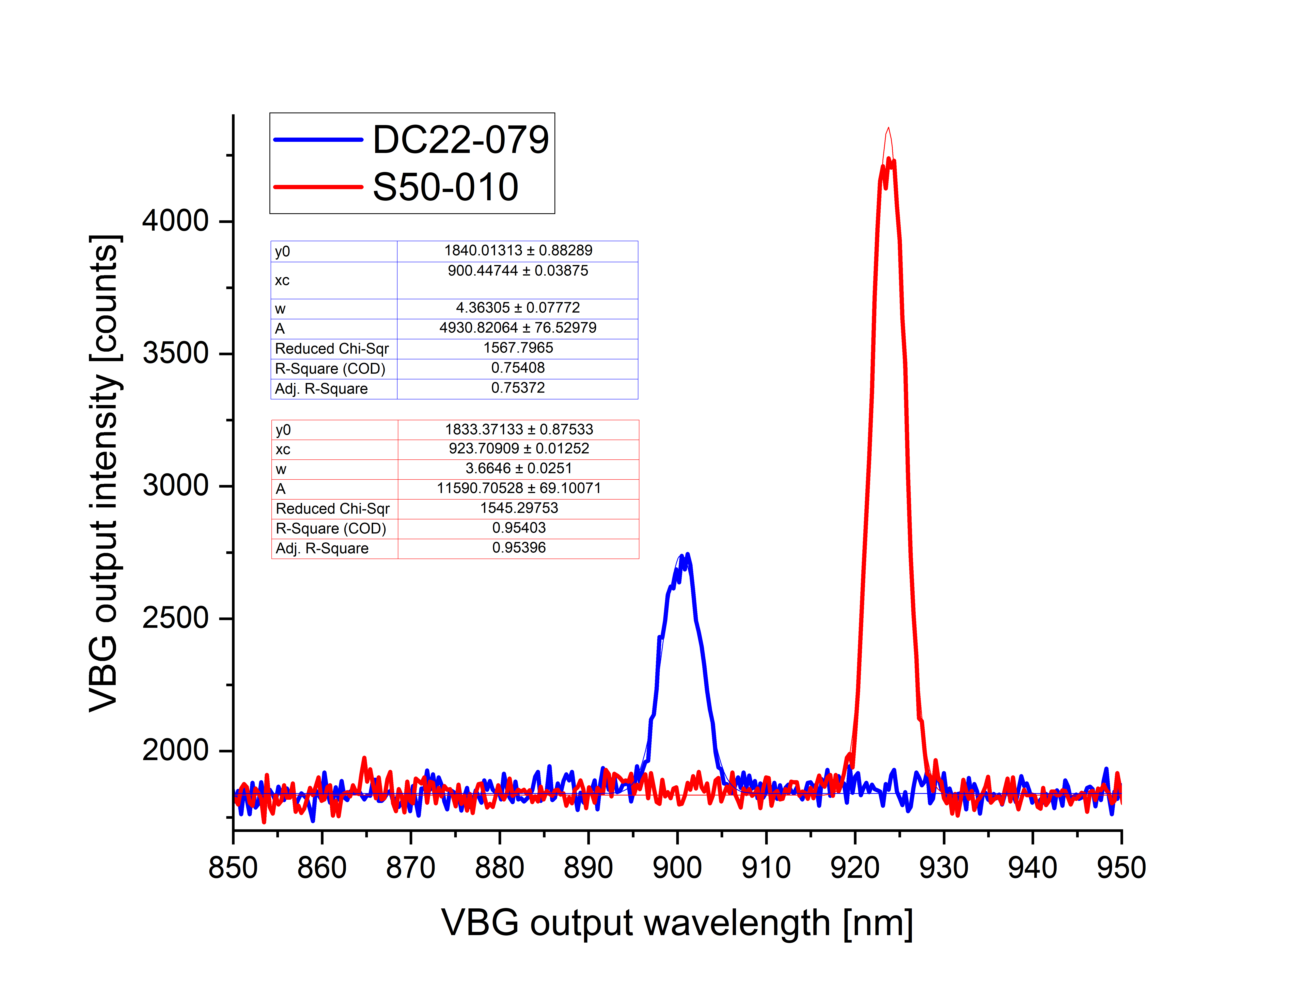
FWHM 3.7 nm
5mm input beam waist
FWHM 4.4 nm
S50-010
DC22-079
The alignment should be adjusted to a different axis to get the daisy chained VBGs to output the desired wavelengths. Experimentally more complex and no finely tuned rotation control.
The S50-010 VBG optimized for a 910nm output displays a 923.7nm output when it aligns with the DC22-079 VBG tuned to output its optimal wavelength i.e. 900nm.
With no daisy chain &
alignment constraints:

